Slide 1

Flight Simulation News September 2026
27 September 2026

Slide 2

BFSG News & Reviews
Presentation on news & reviews will start at:
12:00h

Slide 3
Parish Notices

Slide 4

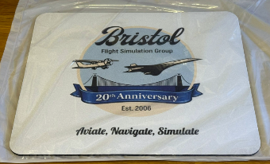
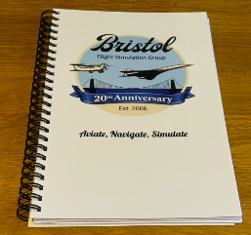
20th Anniversary Logo
£5 each
£5 each
Foam back mouse mat
A5 notebook (lined / plain)

Slide 5


Monthly Meeting Dates
2026 Monthly Meeting Dates
10th & 11th October –
25th October – next meeting
22nd November
13th December

Slide 6


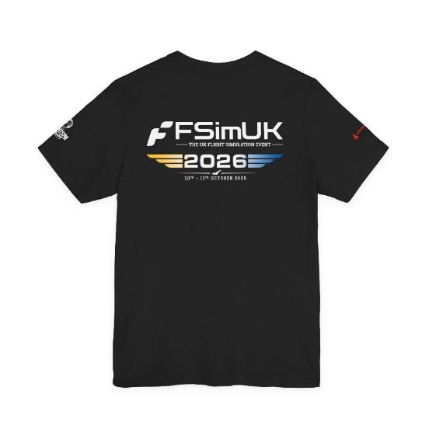
FSimUK 2026
£23.00
https://flightsimtees.com/products/fsim-uk-2026-official-event-tee

Slide 7
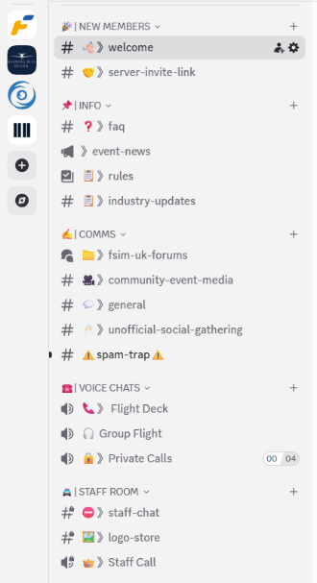
FSimUK 2026
Come and join the conversation
https://discord.gg/4BcsYh8J9s

Slide 8
BFSG Weekly
Virtual Fly-ins Update

Slide 9
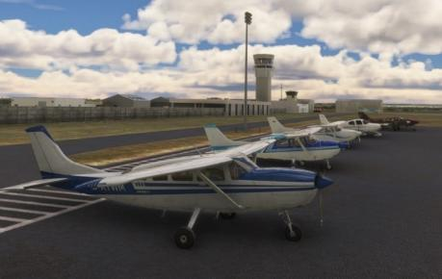
GA Virtual Flying Update
GA Virtual Flying Update
25Aug26 A club flight in Tennessee then Alabama and back into Tennessee Flight plan by Tony Price KCHA 7A6 8A1 KHUA KHSV KDCU KSNH. ( 10 pilots took part).
01Sep26 A mountains and canyons tour wwith passengers, in Colorado USA. Flight plan by Martin Chatterton. KBJC KGNB 20V KEGE KGWS (8 pilots took part)..
08Sep26 An aircraft ferry company has given us the job of flying some turbine powered aircraft from Samarkand in Tajikistan, to Qurgonteppa in Turkey. Flight plan by Richard Preston. UTSS UTPA UYAY UTDD UTDT (10 pilots took part)..
15Sep26 Club flight from Elstree to Cardiff, without using any satellite navigation aids. (no connection between the sim and Littlenavmap) Plan by Ian Lassman. EGTR EGTB EGOC EGBP EGBJ EGMX EGFF. (10 pilots took part).
22Sep26 Transporting some tourists from Croatia through Slovenia to a small airfield near Venice. Flight plan by Bob Barry. LDLO LDPL LDPV LJPZ LIPI. (7 pilots took part).
Tuesday evenings, from 19:30h
PoC: Mike C

Slide 10
Heavies Virtual Flying Update
Heavies Virtual Flying Update
Our group meets online at 18:30 hrs UK time on Thursday evenings and we aim to finish our flights by 21:00 hrs UK time. This requires periods of “Warp Factor” flying for those longer flights.
Week 35 – Aug27th – Hamburg (EDDH) & Frankfurt / Main (EDDF) to Manchester (EGCC) – 500/510nm – 14 no. – Joint Fly-in with Gatwick Group
Week 36 – Sep 3rd – Tawau, Malaysia (WBKW) to Ranai-Natuna, Indonesia (WIDO) – 596nm – 9 no.
Week 37 – Sep 10th – Ranai-Natuna, Indonesia (WIDO) to Kualanamu, Indonesia (WIMM) – 572nm – 9 no.
Week 38 – Sep17th – Kualanamu, Indonesia (WIMM) to Bangkok, Thailand (WTBD) – 655nm – 7 no.
Week 34 – Sep 24th – Berlin Brandenburg (EDDB) & Geneva (LSGG) to London Stansted (EGSS) – 505/495nm – 13 no. – Joint Fly-in with Gatwick Group
Thursdays 18:30-21:00h
PoC: Marcus S
In addition, a combined BFSG and Aviators Eindhoven joint fly-in occurs once a month on Saturday mornings at 10:00hrs UK time
Sep 12th – Newcastle, UK (EGNT) to Sion, Switzerland (LSGS) - 717nm

Slide 11

Inter-meeting Lunches
Meet in Chippenham
Organised by Pete A
Next : Fri 16th Oct 2026
Speak to Pete and be added to email list

Slide 12
Flight Simulator News

Slide 13




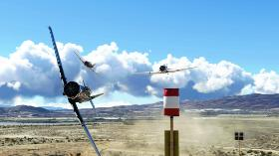
Microsoft Updates
Microsoft Updates
City Update 16
https://www.flightsimulator.com/microsoft-flight-simulator-releases-city-update-16-italy/
  City Update 16 highlights nine urban areas throughout Italy, ranging from the country’s north to its southern tip, including the islands of Sardinia and Sicily
Local Legend 23
https://www.flightsimulator.com/microsoft-flight-simulator-releases-local-legend-25-the-heinkel-he-70-blitz/
  Heinkel He 70 Blitz
  ships with several historically precise liveries, including those officially licensed by Lufthansa
Coming 13th October
https://www.flightsimulator.com/microsoft-flight-simulator-releases-local-legend-25-the-heinkel-he-70-blitz/
  The world’s fastest motorsport, National Championship Air Races
  Five different race classes will be included: the Unlimited Class (featuring the P-51 Mustang), the T-6 Class (featuring the North American T-6 Texan), the Biplane Class (featuring the Aviat Pitts Special S1S), the Jet Class (featuring the Aero Vodochody L-39) and – for the very first time – the STOL Class featuring an exciting new 1 vs. 1 drag-race experience.

Slide 14

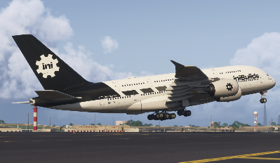
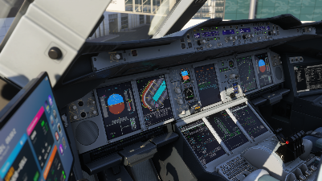
iniBuilds Airbus A380
iniBuilds A380
iniBuilds and Microsoft have released the long awaited A380 exclusively to the game’s Marketplace.
Two liveries at launch, with more promised
Deep avionics simulation
Two distinct engine variants: RR Trent 900 and Engine Alliance GP7200
Bespoke A380 flight model
Plus the most important - Functional onboard showers
COST: Introductory price $74.49 USD

Slide 15
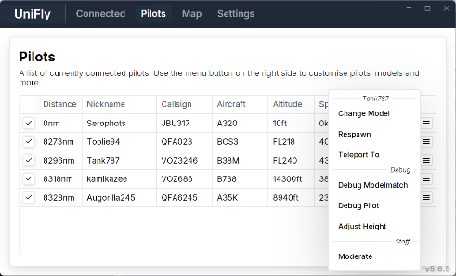

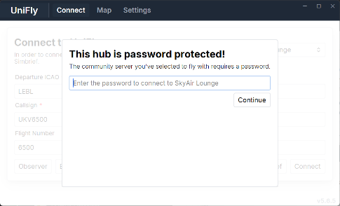
UniFly - Any simulator, one sky
UniFly
A new multiplayer network empowering casual flying
Free to use
model matching made easy, with support for FSLTL models out of the box
Can host a private servers
https://unifly.gg/
FSLTL is meant to be good for heavies, not so much for GA. We should test this out

Slide 16

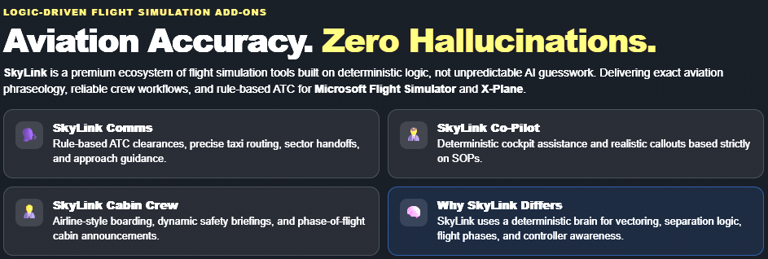
Skylink ATC
Skylink ATC
Deterministic ATC client (no AI pure logic)
Works with Xbox and PS5
Can add AI Copilot and Cabin Crew
It’s a one-off payment
https://www.flywithskylink.com/

Slide 17



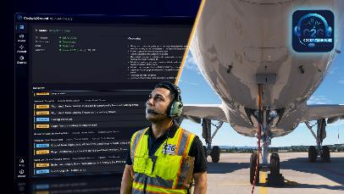
First Officers / Ground Crew
Two options seemed to have appeared recently
Built for realistic cockpit workflows
Designed around real procedures and crew interaction
Continuously updated for modern flight simulation
Supports: PMDG 737, PMDG 777, Fenix Airbus and more
One off payment – AI usage is not charged
Cockpit2Ground
Pushback and engine start
De-Icing & arrival
180 unique voices
Requires GSX

Slide 18







Burning Blue Vegetation
Enhanced Global Vegetation
Enhances:
Forests
Towns
Wetlands / grasslands
Deserts
Plantations
Seasonal landscapes
COST: £10.95
https://burningbluedesign.com/product/enhanced-global-vegetation/

Slide 19

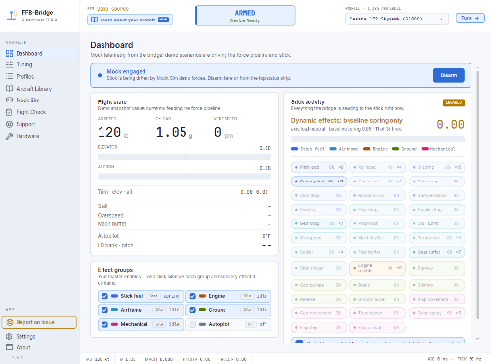
FFB-Bridge
FFB-Bridge
Free app that supports multiple FFB controllers
Initially was for the MS FFB Sidewinder Joystick
Logitech G940 support was added
Brunner and Moza devices are now supported
Moza are partnering with FFB-Bridge
(https://ffb-bridge.com/moza-partnership )
Library of 703 aircraft profiles (for now)
Works with 2020/2024 and Xplane on Windows/Linux/MacOS
COST: FREE
For anyone with a FFB controller supported I recommend trying this out. https://ffb-bridge.com/

