Slide 1

Flight Simulation News July 2026
26 July 2026

Slide 2

BFSG News & Reviews
Presentation on news & reviews will start at:
12:00h

Slide 3
Parish Notices

Slide 4


Monthly Meeting Dates
2026 Monthly Meeting Dates
23rd August – Next meeting
27th September
10th & 11th October –
25th October
22nd November
13th December

Slide 5

FSimUK 2026
https://fsimuk.bfsg.club

Slide 6


FSimUK 2026
£23.00
https://flightsimtees.com/products/fsim-uk-2026-official-event-tee

Slide 7
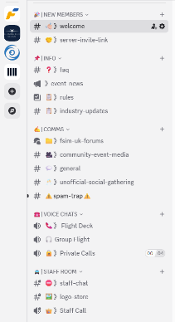
FSimUK 2026
Come and join the conversation
https://discord.gg/4BcsYh8J9s

Slide 8
BFSG Open Day
28 June 2026

Slide 9
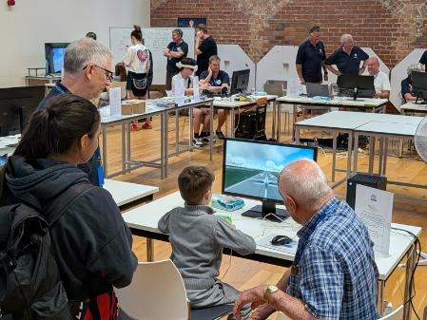
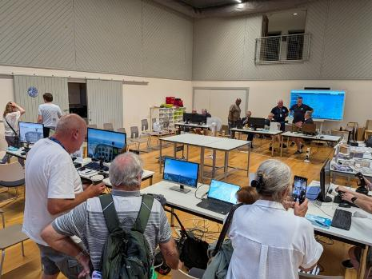
BFSG Open Day 2026

Slide 10
BFSG Weekly
Virtual Fly-ins Update

Slide 11
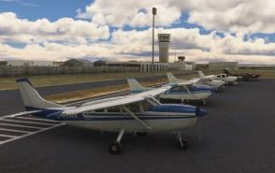
GA Virtual Flying Update #1
GA Virtual Flying Update
26.05.2026 Transporting anglers and their gear on a trip from Wrangell into Canada. Flight plan by Mike Collins. PAWG CAB5 CBW4 CBU2 CYDL. (7 pilots)
02.06.2026 Scenic flight from Lydd to Eindhoven. Flight plan by Tony Price. EGMD LFAC EBFN EBOS EBZU EHBU EHRD EHEH (11 pilots)
09.06.2036 Transporting tourists from The Greek Islands back to Bodrum in Turkey for their return flights back to the UK. Flight plan by Bob Barry. LGIK LGSM LGLE LGKY LGKO LTFE.(10 pilots)
16.06.2026 "Air Race around Salisbury Plain" Smaller aircraft order of the day. Inline abreast takeoff from Middle Wallop to Thruxton. Flight plan by Tim Nutt. EGVP EGME EGHA EGHO (9 pilots)
23.06.2026 Transporting scientists to collect water samples in Japan. Flight plan by Ian Lassman. RJT1 Stopping at various lakes enroute to Lake Suwa. (6 pilots)
Tuesday evenings, from 19:30h
PoC: Mike Collins

Slide 12
GA Virtual Flying Update #2
GA Virtual Flying Update
30.06.2026 A casual flight around Martha's Vineyard checking out points of interest. Flight plan by Martin Chatterton. 1B2 KACK KHYA KCQX KPVC 2B1 KMVY. (10 pilots)
07.07.2026 Flying for The Chile Post Special Delivery Service, with a senior official on board. Flight plan by Richard Preston. SCVM SCOM SCFL SCCV SCVT SCAU SCVF SCSN.
(8 pilots)
14.07.2026 Transporting tourists for sightseeing flights in Northern Romania. Flight plan by Dave Simmons. LRSM LRBM LRBN LRFL LRSV. (10 pilots)
21.07.2026 A club flight from Culpepper in Virginia to Ocean City Muni. in Maryland. Flight. Special permission had been given to land at military fields (some of these important research and launch sites). Plan by Mike Collins. KCJR KEZF KNDY KNHK KWAL KOXB. (10 pilots)
Tuesday evenings, from 19:30h
PoC: Mike Collins

Slide 13
Heavies Virtual Flying Update #1
Heavies Virtual Flying Update
Week 22 – May 28th – Santiago Arturo Merino Benitez Intl. (SCEL) to Buenos Aires Ezeiza Intl.- Ministro Pistarini (SAEZ) – 660nm – 12 pilots
Week 23 – Jun 4th – Buenos Aires Ezeiza Intl. - Ministro Pistarini (SAEZ) or Sao Paulo Guarulhos (SBGR) to Porto Alegre Salgado Filho Intl. (SBPA) – 500nm – 18 pilots – Joint Fly-in
Week 24 – Jun 11th – Porto Alegre Salgado Filho Intl. (SBPA) to Rio De Janeiro Galeao-Antonio Carlos Jobim Intl. (SBGL) – 640nm – 11 pilots
Week 25 – Jun 18th – Auckland (NZAA) to Queenstown (NZQN) – 585nm – 10 pilots
Week 26 – Jun 25th – Sydney Kingsford Smith (YSSY) to Adelaide Intl. (YPAD) – 655nm – 7 pilots
Thursdays 18:30-21:00h
PoC: Marcus Szczepanek
In addition, a combined BFSG and Aviators Eindhoven joint fly-in occurs once a month on Saturday mornings at 10:00hrs UK time
Jun 13th – Lanzarote, Canary Islands (GCRR) to Tenerife North, Tenerife (KMEM) - 147nm
Tenerife North, Tenerife (KMEM) to Fuerteventura, Canary Islands (GCFV) – 140nm

Slide 14
Heavies Virtual Flying Update #2
Heavies Virtual Flying Update
Week 27 – Jul 2nd – Brussels National (EBBR) to Barcelona Josep Tarradellas (LEBL) – 645nm – 9 no.
Week 28 – Jul 9th – Geneva (LSGG) to Rijeka KRK Island (LDRI) – 430nm – 6 no.
Week 29 – Jul 16th – Rijeka KRK Island (LDRI) to Tirana (LATI) – 375nm – 7 no.
Week 30 – Jul 23rd – Tirana (LATI) to Iraklion Nikos Kazantzakis (LGIR) – 510nm – 6 no.
Thursdays 18:30-21:00h
PoC: Marcus Szczepanek

Slide 15
FS Expo 2026
St. Pauls, USA

Slide 16

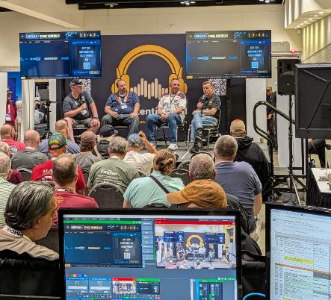
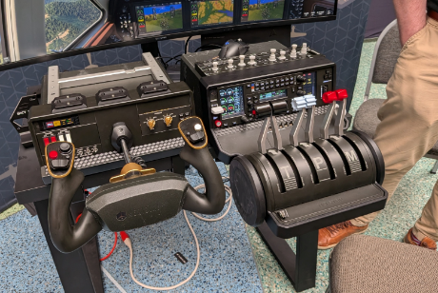
FS Expo 2026
https://meridiangmt.com

Slide 17
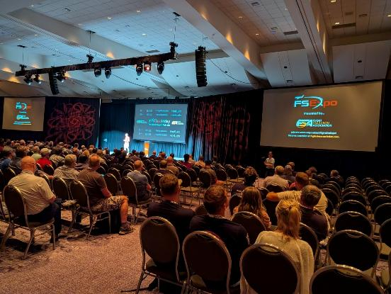
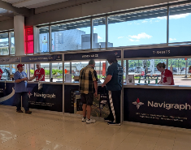
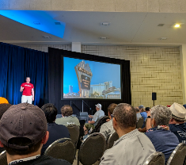
FS Expo 2026

Slide 18
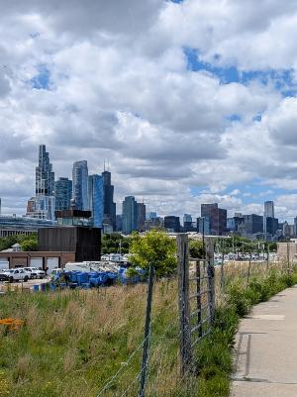
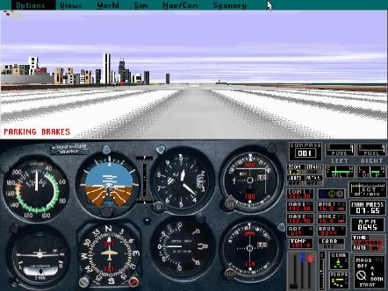
FS Expo 2026
Meigs Field

