Slide 1

Flight Simulation News August 2026
23 August 2026

Slide 2
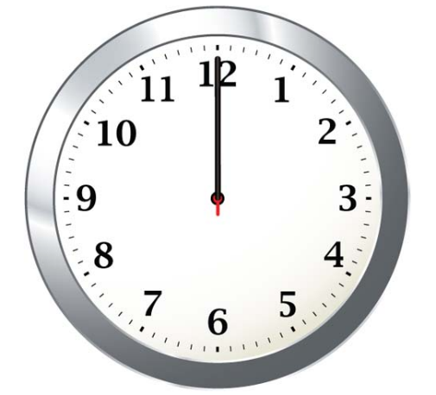
BFSG News & Reviews
Presentation on news & reviews will start at:
12:00h

Slide 3
Parish Notices

Slide 4


Monthly Meeting Dates
2026 Monthly Meeting Dates
27th September – next meeting
10th & 11th October –
25th October
22nd November
13th December

Slide 5

FSimUK 2026
51 exhibitors now:
Exhibitors & Sponsors
https://fsimuk.bfsg.club

Slide 6



PC Pilot

Slide 7



FSimUK 2026
£23.00
https://flightsimtees.com/products/fsim-uk-2026-official-event-tee

Slide 8

FSimUK 2026
Come and join the conversation
https://discord.gg/4BcsYh8J9s

Slide 9
BFSG Weekly
Virtual Fly-ins Update

Slide 10
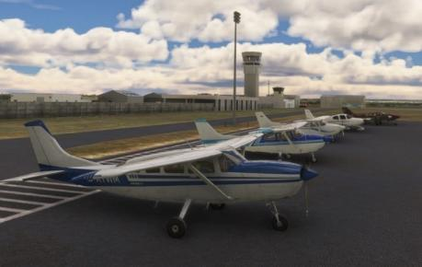
GA Virtual Flying Update
GA Virtual Flying Update
28Jul26 Delivering crates of wine to some remote areas of Northern Italy and Switzerland. Flight plan by Pete Norton.LIPX LIDH LIDT LIPB LIQM LILO LSZA. (10 pilots took part)
04Aug26 An aerial photographic trip in Australia to photograph "The Marree Man". Flight plan by Pete Allnutt. YMRE YMLR "The Marree Man" YROO YMRE. (10 pilots took part).
11Aug26 Transporting ex military personnel to a reunion at St Gallen Altenrhein in Switzerland. Flight plan by John Sharman. LSZB LSGR LSMM LSME LSZH LSPV LSZE LSZR. (7 pilots took part).
18Aug26 A scenic flight from North Carolina into Tennessee. Flight plan by Mike Collins. NC06 2NC0 KGKT KMNV KCHA. (11 pilots took part).
Tuesday evenings, from 19:30h
PoC: Mike C

Slide 11
Heavies Virtual Flying Update
Heavies Virtual Flying Update
Week 31 – Jul 30th – Toulouse Blagnac (LFBO) & Milan Malpensa (LIMC) to London Gatwick (EGKK) – 540/515nm – 10 no. – Joint Fly-in with Gatwick Group
Week 32 – Aug 6th – Kota Kinabalu (WBKK) to Manado Sam Ratulangi (WAMM) – 611nm – 11 no.
Week 33 – Aug 13th – Manado Sam Ratulangi (WAMM) to Ujung Padang (WAAA) – 511nm – 8 no.
Week 34 – Aug 20th – Ujung Padang (WAAA) to Tawau (WBKW) – 641nm – ? no.
Thursdays 18:30-21:00h
PoC: Marcus S
In addition, a combined BFSG and Aviators Eindhoven joint fly-in occurs once a month on Saturday mornings at 10:00hrs UK time
No flight

