Slide 1

Flight Simulation News May 2026
24 May 2026

Slide 2

BFSG News & Reviews
Presentation on news & reviews will start at:
12:00h

Slide 3
Parish Notices

Slide 4

Monthly Meeting Dates
2026 Monthly Meeting Dates
28th June – Open Day
26th July
23rd August
27th September
25th October
22nd November
13th December

Slide 5

Inter-meeting Lunches
Meet in Chippenham
Organised by Pete A
Next Lunch: Fri 05th June 2026
Speak to Pete and be added to email list

Slide 6
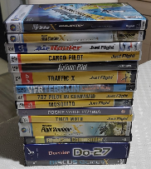

Old flight simulator software
Old flight simulator software
Many of us have old software..
So far, now raised: £500.00
Please continue to bring along, if happy for proceeds to go to club funds.
Anybody have this?

Slide 7
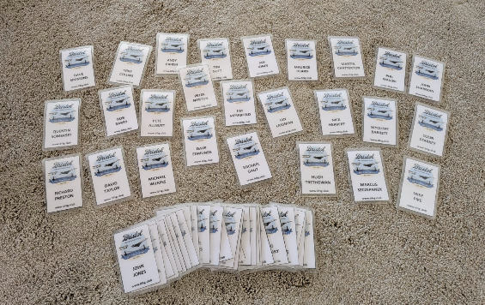
BFSG 20th Anniversary Badges
New badges to collect…
Please ensure you wear your badge next month for BFSG Open Day

Slide 8

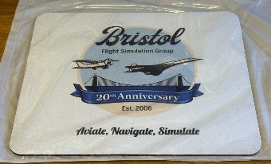
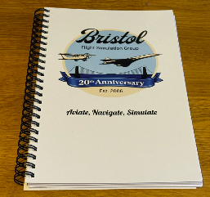
20th Anniversary Merchandise
£5 each
£5 each
Foam back mouse mat
A5 notebook (lined / plain)

Slide 9
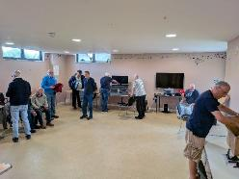
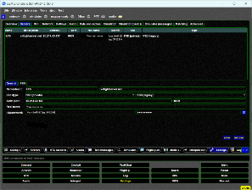

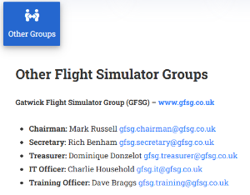
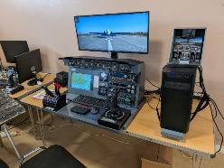

Gatwick Flight Simulation Group Visit
NEW
Swift - https://swift-project.org/
Teamspeak3 https://www.teamspeak.com
https://www.gfsg.co.uk

Slide 10

UK Flight Sim Event
Update on UK flight sim event…
In discussions with Aerospace Bristol and 10th and 11th October 2026

Slide 11
BFSG Weekly
Virtual Fly-ins Update

Slide 12
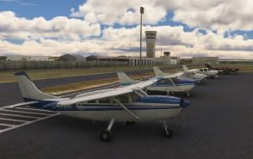
GA Virtual Flying Update
GA Virtual Flying Update
28.04.2026 A trip for submarine crew members around Perth, Australia. Flight plan by Martin Chatterton. YGAD YMUL YPJT YMWR YGIG YRRD YRTI. (10 pilots)
05.05.2026 Transporting cases of wine for a Spanish Wine Company in The Pyrenees.
Flight plan by Pete Norton. LEZA LEHC LENA LESU LFIP Pic du Midi Observatory LFBT.
(9 pilots)
12.05.2026 A trip in Japan with a photographer, commissioned to photograph two large dams for "Big Dams Magazine". Having a quick look at Suzuka Race Circuit en route.
Flight plan by Pete Allnutt. RJOE RJNA RJNG RJNF. (9 pilots)
19.05.2026 A flight to replicate one of the legs (Leg 6) that the Spitfire flew, around the UK to commemorate the 90th Anniversary of the 1st Flight of K5054. Flight plan by John Sharman. EGOV EGCK EGFD EGFA EGFE EGFP EGFH EGDX. (11 pilots)
Aircraft used for this flight were: Spitfires (8) Anson (1) Rapide (1) Lysander (1)
Tuesday evenings, from 19:30h
PoC: Mike C

Slide 13
Heavies Virtual Flying Update
Heavies Virtual Flying Update
Week 18 – 30 Apr – Ashgabat (UTAA) to Baku Heydar Aliyev Intl. (UBBB) – 460nm – 12 pilots
Week 19 – 07 May – Baku Heydar Aliyev Intl. (UBBB) to Sochi (URSS) – 525nm – 13 pilots
Week 20 – 14 May – Chiang Mai Intl. (VTCC) to Hanoi Noi Bai Intl. (VVNB) – 435nm
Week 21 – 21 May – Hanoi Noi Bai Intl. (VVNB) to Hong Kong Intl. (VHHH) – 615nm
Thursdays 18:30-21:00h
PoC: Marcus S
In addition, a combined BFSG and Aviators Eindhoven joint fly-in occurs once a month on Saturday mornings at 10:00hrs UK time
  09th May 2026:
  Madrid, Spain (LEMD) to Amsterdam, Netherlands (EHAM) - 803nm

Slide 14

Monthly Flying Tip
..over to
Pete A to explain….
https://www.cixvfrclub.org.uk/index.php

Slide 15
Flight Simulator News

Slide 16



Navigraph Academy
Navigraph Academy
Introduction of Instrument Flying training package:
Learn to fly confidently without outside visual references
Master the fundamentals of instrument scan and control
Plan and fly realistic IFR routes using charts & procedures
Fly accurate and stable ILS approaches
Understand why pilots do what they do, not just how
Learn from experienced real-world pilots and instructors
FREE!
https://academy.navigraph.com

Slide 17
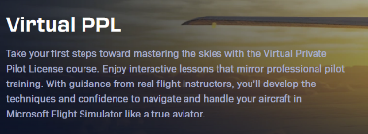

Navigraph Academy
Virtual PPL – Mike P has been completing the training…
Flight training from professional flying instructors
Theory in detail with excellent graphics
Short theory test
Full Navigraph “SOP” for flying the Cessna 172
Practical demonstration from the captain’s seat by the instructor
Solo practice by the student
Full analysis afterwards including all the telemetry of the flights
Plenty of encouragement during the demonstrations and by email
https://www.youtube.com/watch?v=r6OBZgBa4ps

Slide 18
Course Outline
Stage 1
    Basic manoeuvring
    Take offs
    Landings
    Circuit
    First “solo”
    Theory test
Stage 2
  Ground handling
  Reading the chart - planning taxi route
  Engine management
  Checklists *Real C172 adapted for flightsim
  Visual navigation techniques (using Navigraph Charts)
  Navex
  vPPL CERTIFICATE AWARDED

Slide 19
Good and Bad
Pros
  FREE to use and follow (No subscription required)
  Best animations I’ve seen showing aerodynamics
  Instrument course now available
  Thoroughly professional quality of both content and presentation
  Main presentations as You Tube videos
Cons
  MSFS 2020/2024 only
  Not available (yet) for X-Plane
  ILS Approach course promised but not yet available
  Nothing available yet (or planned) beyond GA flying

Slide 20
Flight Simulator News

Slide 21
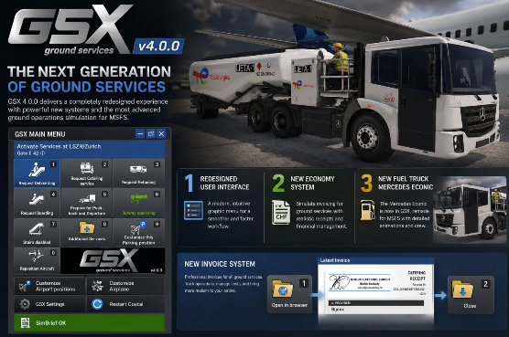
FSDT GSX Pro
New version 4.0 released.
https://www.fsdreamteam.com/products_gsxpro.html

Slide 22
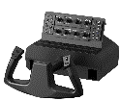
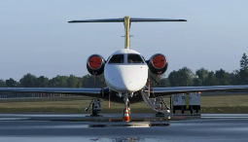
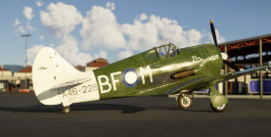
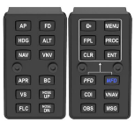
Other notable releases
FSReborn Embraer Phenom 300E
Local Legend 24:
CAC Boomerang
pulsAIR module
…one of the most popular biz jets. Seats 8 PAX, 2000nm range at Mach 0.80, cruising at FL450
Now Available for MSFS; a historic World War II aircraft
Push-button modules for GA flight simulation; ships May ‘26
the natural companion to rotAIR
Cost $39.99 ~ £30
Cost $14.99 ~ £11.20
Cost €110 ~ £95
Microsoft Marketplace
Microsoft Marketplace
https://simflightservices.com/shop/air-modules/pulsair/

