Slide 1

Flight Simulation News April 2026
26 April 2026

Slide 2

BFSG News & Reviews
Presentation on news & reviews will start at:
12:00h

Slide 3
Parish Notices

Slide 4

Monthly Meeting Dates
2026 Monthly Meeting Dates
24th May
28th June – Open Day
26th July
23rd August
27th September
25th October
22nd November
13th December

Slide 5
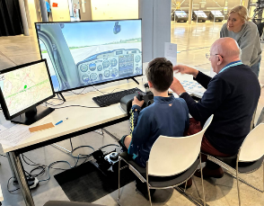
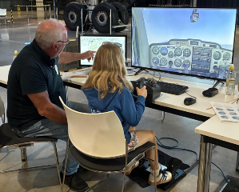
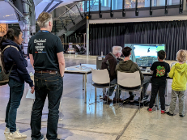
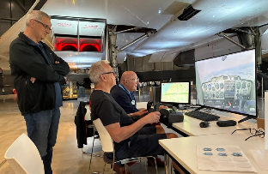
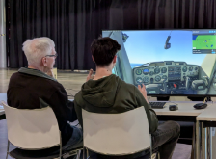
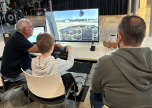
Easter at the Aerospace Bristol

Slide 6

Inter-meeting Lunches
Meet in Chippenham
Organised by Pete A
Next : Fri 08th May 2026
Speak to Pete and be added to email list

Slide 7
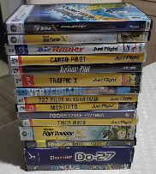

Old flight simulator software
Old flight simulator software
Many of us have old software..
So far, now raised: £468.00
Please continue to bring along, if happy for proceeds to go to club funds.
Anybody have this?

Slide 8

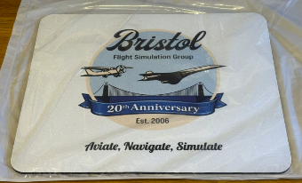
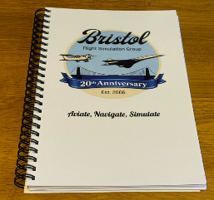
20th Anniversary Logo
£5 each
£5 each
Foam back mouse mat
A5 notebook (lined / plain)

Slide 9

BFSG Special Interest Groups ?
Candidate SIGs
We’d need the following:
Purpose & Scope
Goal(s)
Meeting cadence agreed
Comms to group
Finance/Budget
Lead/Moderator
Active members!
BFSG Concorde SIG
BFSG War Birds SIG
BFSG Formation Flying SIG
BFSG Open Day Planners SIG
BFSG X-Plane SIG
Any other ideas?

Slide 10
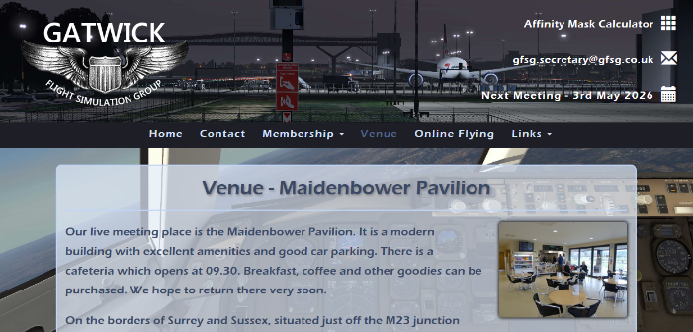
Gatwick Flight Simulation Group
I’m visiting next weekend…
…will report back
https://www.gfsg.co.uk

Slide 11
BFSG Weekly
Virtual Fly-ins Update

Slide 12
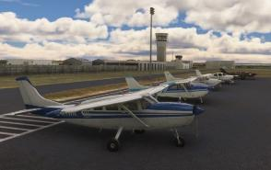
GA Virtual Flying Update
GA Virtual Flying Update
24Mar26 Delivering supplies for Japanese cuckoo clocks in Papua, with financial penalties for missing any airfields! Flight plan by Ian Lassman. WAVC WAOE WADU WAVB WAWI WAWX WAXK WABK. (10 pilots)
31Mar26 A club flight in Chile, having log books stamped at as many airfields as possible. Flight plan by Mike Collins. SCBQ SCLC SCVH SCAN SCQL SCCV SCRD SCER. (11 pilots)
07Apr26 A flight through mountain terrain in Northern Greece with a close up look at The Vikos Gorge, and a couple of stops en route. Flight plan by Richard Preston. LGKA LGIO LGKR. (11 pilots)
14Apr26 Transporting critically ill patients to Lisbon for vital surgery. Flight plan by Dave Simmons. LPCO LPLZ LPPN LPTN LPSC LPPT. (11 pilots)
21Apr26 A scenic flight in Italy to see points of interest. Flight plan by Mike Collins. LIRI LINT LIRF. (10 pilots)
Tuesday evenings, from 19:30h
PoC: Mike C

Slide 13
Heavies Virtual Flying Update
Heavies Virtual Flying Update
Week 13 – 26th Mar – Phoenix Sky Harbor Intl. (KPHX) to San Francisco Intl. (KFSO) – 625nm – 9 pilots
Week 14 – 02nd Apr – Tampa Intl. (KTPA) to Memphis Frederick W Smith Intl. (KMEM) – 590nm – 11 pilots
Week 15 – 09th Apr – Memphis Frederick W Smith Intl. (KMEM) to Rochester Intl. (KRST) – 550nm – 11 pilots
Week 16 – 16th Apr – Brussels National (EBBR) to Belfast Aldergrove (EGAA) – 510nm – 8 pilots
Week 17 – 23rd Apr – Kabul Intl. (OAKB) to Ashgabat (UTAA) – 665nm – 11 pilots
Thursdays 18:30-21:00h
PoC: Marcus S
In addition, a combined BFSG and Aviators Eindhoven joint fly-in occurs once a month on Saturday mornings at 10:00hrs UK time
11th April 2026:
Oslo(ENGM), Norway to Aarhus (EKAH), Denmark - 254nm
Aarhus (EKAH), Denmark to Hannover (EDDV), Germany - 289nm

Slide 14
Flight Simulator News

Slide 15

FSWeekend
The major announcements from FSWeekend
running 21-22 March 2026, Aviodrome Lelystad, Netherlands.

Slide 16



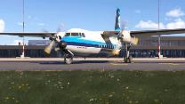
FSWeekend: Microsoft
Microsoft Updates
City Update 14 Released during FSWeekend
high-fidelity landmarks and surface texturing for the Netherlands and Belgium
Sim Update 5 (releasing very soon)
PlayStation VR2 support, multi-player improvements, weather updates, rendering issues fixed
five aircraft receiving significant upgrades
Aircraft & Avionics Update AAU4 (part of Sim Update 5)
Avidyne IFD 540 and IFD 550 coming
AAU5 and AAU6 are already planned
Local Legend 23 (released during FSWeekend)
Fokker F27 Friendship, developed by iniBuilds
https://www.flightsimulator.com/city-update-14/
Updated aircraft:
ATR-42 & ATR-72
Antonov AN-2
Fokker F.VII
Latécoère 631
Savoia Marchetti S55 & S55X
https://www.flightsimulator.com/local-legend-23/

Slide 17

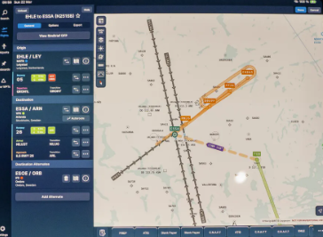

FSWeekend: Navigraph
Updates
Approach Bundle released 26Mar26:
Approach Feathers
Extended Runway Centerlines
Measurement Tool

Slide 18

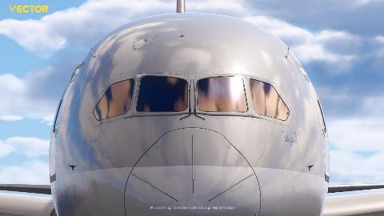
FSWeekend: Vector Studio
Updates
Boeing 787-9 Dreamliner
Coming in 2026
Known internally as Project Griffin
Developed alongside 787 pilots
https://vector-sim.com/

Slide 19

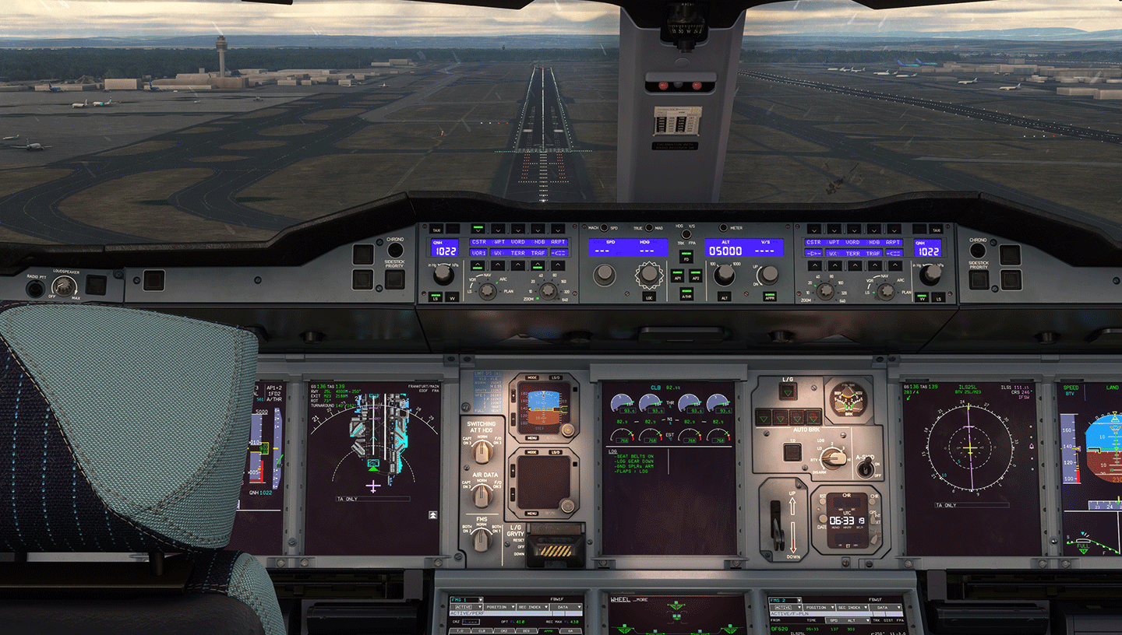

FSWeekend: FlyByWire
Updates
Confirmed a native MSFS 2024 A380X
Performance gains of up to 50%
Resource-saving option to disable the passenger cabin
https://flybywiresim.com/projects/a380x/

Slide 20

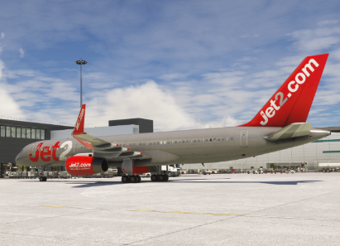
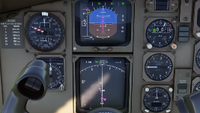

FSWeekend: BlueBird Simulations
Updates
757-200 & 300 in development
Release autumn 2026?
https://bluebirdsim.com/bluebird-757

Slide 21

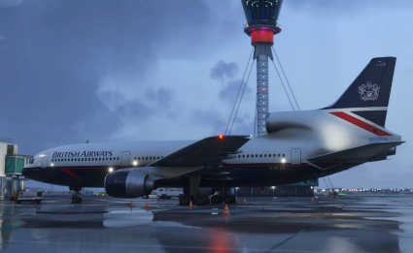
FSWeekend: iniBuilds
Updates
iniBuilds TriStar for MSFS2024 released
Advanced Automatic Flight Control System
Full CAT IIIB Autoland
Fully simulated triple INS setup
Paper Flight Bag (PFB)
Virtual Flight Engineer Autocomplete system
Cost: $49.99 / ~£37
https://inibuilds.com/products/inibuilds-tristar-airliner-msfs-2024

Slide 22

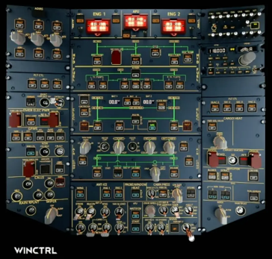
FSWeekend: WinCTRL
Updates
Model: OVHD32 SOP
A320 Overhead Panel
Fully functional
True-to-scale
Integrates with SimPro 2 software
first prototype was shown at FSWeekend
More details in June (FSExpo in USA)
Cost: $349.95
https://www.youtube.com/watch?v=zOK3gSGu2B8

Slide 23

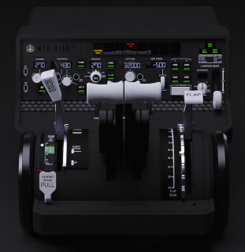
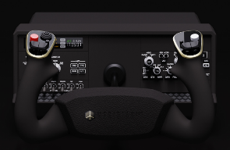
FSWeekend: Meridian GMT
Updates
Horizon+ Yoke
Latitude+ Throttle
Throttle will include servo kit to keep position in sync
3 position gear lever
Avionics expansion bays
Yoke includes magnetic mount for iPad
Launch in 2026?
Cost: $349.99 each ?
Horizon Plus Flight Controls
Latitude Plus Throttle Quadrant
https://meridiangmt.com/products/latitude-plus-throttle-quadrant/
https://meridiangmt.com/products/horizon-plus-flight-controls/

Slide 24


FSWeekend: Moza
Updates
MGX1000 Instrument Panel
Modern glass cockpit
10.4-inch IPS display
Tactile rotary encoders
2026 release
Cost: tbc

Slide 25



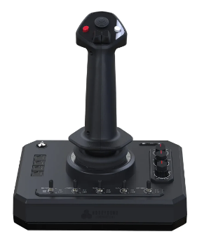
FSWeekend: Honeycomb
Updates
Foxtrot Aviation Stick
5 switches
4 action buttons
2 rocker switches
1 POV switch
Left/right twist
Cost: $149.99 / ~£111
Camera
Toolbar
Checklist
3-way starter switch
4-way radio switch
5-way auto-pilot
https://eu.flyhoneycomb.com/products/foxtrot-aviation-stick

Slide 26


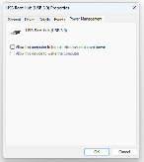
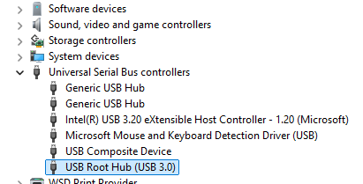
Monthly Flying Tip
USB Power Management
Random Disconnects: Peripherals may shut off mid-flight, often accompanied by the Windows "device disconnected" chime.
Failed Re-engagement: Once Windows puts a port to sleep, it may fail to "wake up" the device when you finally provide input (e.g., disengaging autopilot to take manual control).
Blank Displays: Dedicated flight instruments or MFD (Multi-Function Display) screens may go dark if Windows determines they haven't sent data recently.
Input Lag: Aggressive power management can lead to a slight delay as the USB port transitions back to a high-power state
USB power management in Microsoft Windows is a well-known issue for home flight simulators.

Slide 27

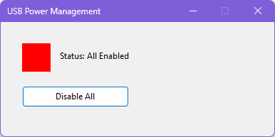
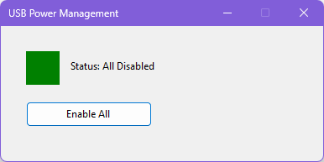
Can we fix it?
Of course we can… (stupid question)
A new program will be uploaded to the website soon
You need to “Run as Administrator” if you want to change the USB Power Management status, otherwise it will only tell you whether it is enabled or not
On first run, you’ll probably see this:
Click here!

Slide 28
Other Flight Simulator News

Slide 29


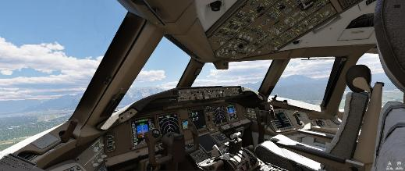
FlightFactor 777 v2
777-300ER v2
777-300ER for X-Plane 11/12
Released 16 Apr 26
Flight model 95-98% accurate
Fully simulated electrical, hydraulic, fuel, and air systems
Weather radar
Cost $89.00 / £66
https://www.flightfactor.aero

Slide 30


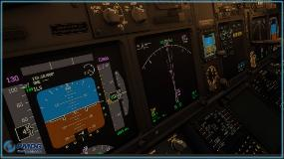
PMDG 737
PMDG 737
Released 09 Apr 26 (737-700)
Major “High Detail Update” (HDU) version
Fully native MSFS2024 SDK
Passenger, Freighter and Biz Jet versions
Owners of the MSFS2020 version are eligible for 60% discount
Released 737-600 HDU on 16Apr26
737-800 and 737-900 HDUs coming
Cost $74.99 / £56
https://pmdg.com/pmdg-737-700-for-microsoft-flight-simulator-2024/

Slide 31

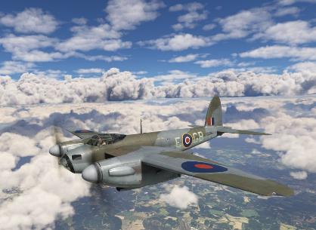
De Havilland DH-98 Mosquito
Aeroplane Heaven Mosquito
Released 13 Apr 26
For MSFS2020/2024
(not native MSFS2024)
Realistic systems & start routines
Authentic sound packs
Highly detailed Rolls Royce Merlins
Cost $32.99 / ~ £24.50
https://www.aeroplaneheaven.com/product_mos.php

Slide 32



Other notable releases
Just Flight Cessna 152 for X-Plane 12
Cardiff Airport (EGFF) for X-Plane 12
World Update 21 for MSFS, covering Australia
…using hands-on research with a real-life C152, G-BGAE, based at Conington Airfield
… Developed by SkyHigh Studios, EGFF, includes GSX profile
…arriving 05th May 2026; 6 new airports coming
Cost £30.49
Cost £10.99
Cost FREE
https://www.justflight.com/product/c152-xplane-12
https://sofly.io/products/cardiff-airport-egff

Slide 33

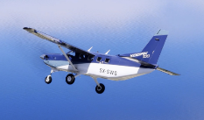
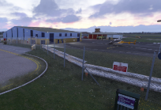
Other notable releases
Burning Blue Design Kemble for MSFS
SWS Kodiak for MSFS2024
Gloucester (freeware) for MSFS
EGBP, Cotswold Airport (Kemble) for MSFS2020 & 2024
Published 1 week ago
Cost £15.95
Cost $34.99 / ~£26
Cost FREE
https://burningbluedesign.com/product/kemble/
https://simworksstudios.com/product/kodiak-100-series-ii-fs2024/
https://en.flightsim.to/addon/107288/egbj-gloucestershire-airport

Slide 34

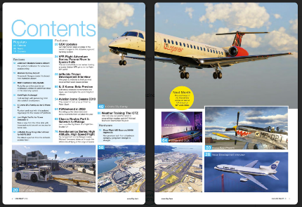
PC Pilot magazine
PC Pilot
CLASSIC ROUTES
Gatwick to Malaga
FS WEEKEND!
All the news from Lelystad 2026
727 PASSENGER EDITION
Classic charter flying
FULL REVIEW
Moza AB9 and MH16 Flight Stick
https://www.key.aero/subscribe-today
https://pocketmags.com/pc-pilot-magazine#

Slide 35

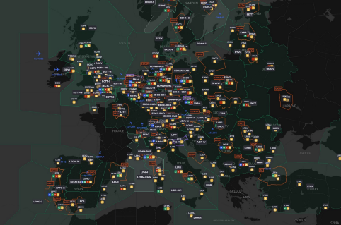

VATSIM Update
11 April 2026
The whole of VATSIM Europe was encouraged to staff as many control positions as possible.
The red text in red boxes are Approach positions.
Airport names show airports that have movements in or out.

Slide 36
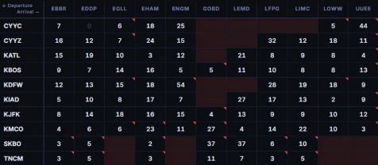

VATSIM Update
25 April 2026
Cross the Pond is a twice-yearly event featuring divisions on both sides of the Atlantic Ocean providing a complete ATC service from your departure to your destination.
This table charted the number of flights available on each route without overloading any North Atlantic tracks.
Slots are allocated by a lottery (they call it a slottery!).
There were 2800 applications.
https://ctp.vatsim.net/

Slide 37
Other Aviation or Space News

Slide 38


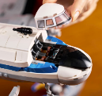

LEGO DC-3
11378: Douglas DC-3 PAN AM Airliner
LEGO Icons series
1903 pieces
Detailed cockpit and passenger cabin
H: 24cm | W: 76cm | D: 51cm
COST: £200
https://www.lego.com/en-gb/product/douglas-dc-3-pan-am-airliner-11378

Slide 39
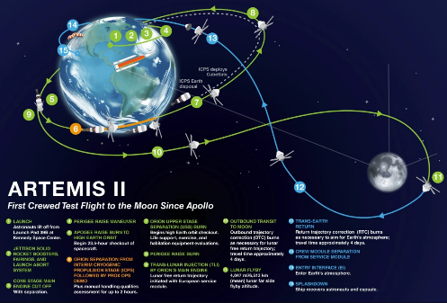
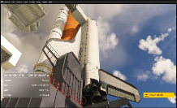
ARTEMIS II
NASA ARTEMIS II
a 10-day crewed test flight
Validated Orion & Space Launch System (SLS) rocket
NASA astronauts:
Reid Wiseman, Victor Glover
Christina Koch, Jeremy Hansen (Canadian)
over 230,000 miles from Earth
4,600 miles beyond the far side of the Moon
WIP: SpacePort for Microsoft Flight Simulator 2020 and 2024, by the Terrabuilder Team
https://www.nasa.gov/mission/artemis-ii/

Slide 40
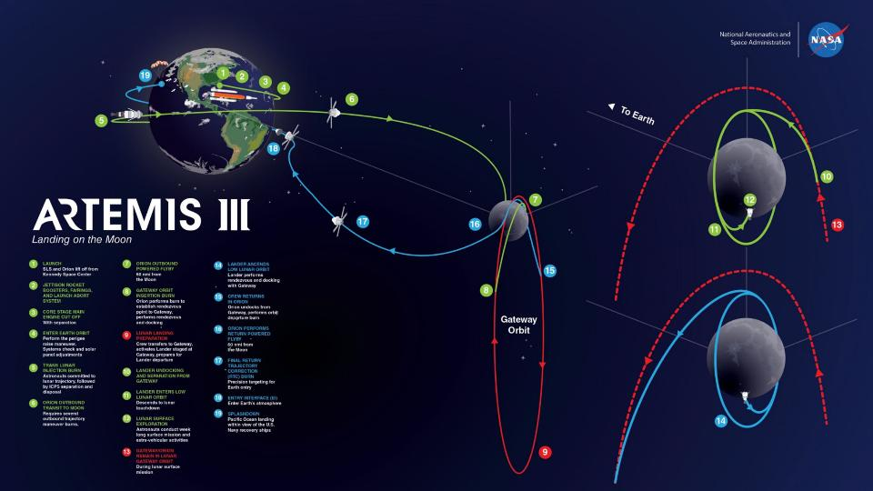

Slide 41
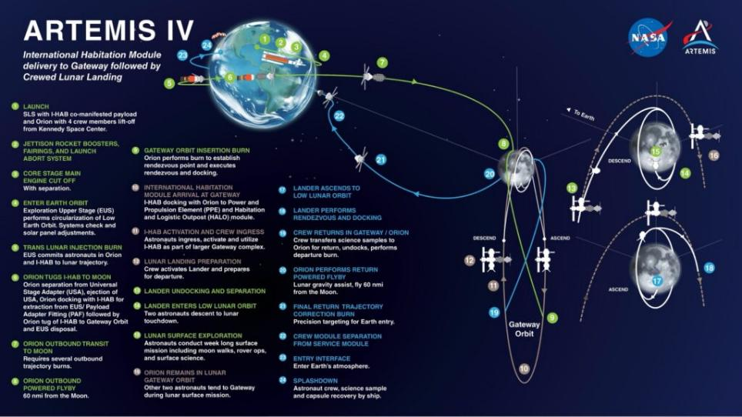

Slide 42
Any Questions?!

