Slide 1

Flight Simulation News February 2026
22 February 2026

Slide 2

BFSG News & Reviews
Presentation on news & reviews will start at:
12:00h

Slide 3
Parish Notices

Slide 4

Monthly Meeting Dates
2026 Monthly Meeting Dates
22nd March
26th April
24th May
28th June
26th July
23rd August
27th September
25th October
22nd November
13th December

Slide 5

Inter-meeting Lunches
Meet in Chippenham
Organised by Pete A
Next : 06th March 2026
Speak to Pete and be added to email list

Slide 6
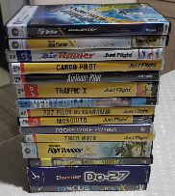

Old flight simulator software
Old flight simulator software
Many of us have old software..
So far, now raised: £468.00
Please continue to bring along, if happy for proceeds to go to club funds.
Anybody have this?

Slide 7
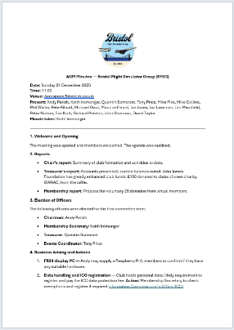
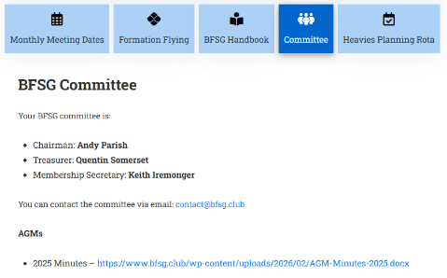
AGM 2025
Minutes now on the website

Slide 8

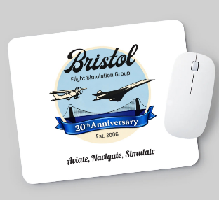

20th Anniversary Logo
£5 each
£5 each
Foam back mouse mat
A5 notebook (lined / plain)

Slide 9
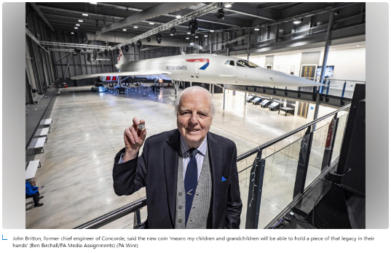
Concorde 50p
A new 50p coin celebrating the speed and elegance of Concorde
Launched by the Royal Mint
Marks 50 years since the aircraft’s first commercial flight
https://www.msn.com/en-gb/travel/news/concorde-50p-coin-takes-off-as-royal-mint-celebrates-supersonic-aircraft/ar-AA1U5g0e

Slide 10



Concorde 50p

Slide 11
Project Updates

Slide 12
Projects
No. | Description | Primary PoC
1 | Aerospace Bristol FlightRadar24 feed | Tim N
2 | Formation Flying | Michael G
3 | X-Plane on Club PC | Keith I
4 | Stream Deck Mini & Discord | Keith I

Slide 13
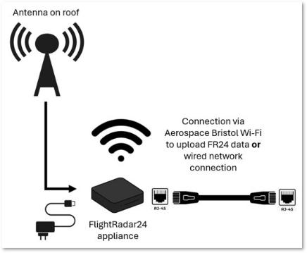
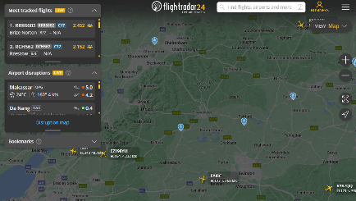
Aerospace Bristol FR24 Update
flightradar24 Install at Aerospace Bristol
BFSG is providing antenna to Aerospace Bristol (£100)

Slide 14
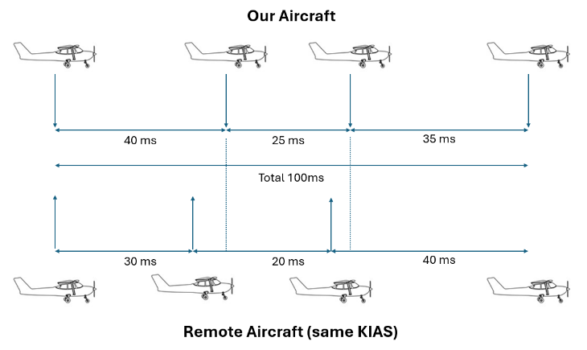
Formation Flying

Slide 15
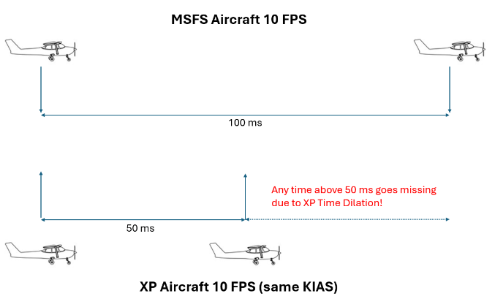
Formation Flying

Slide 16
Club PC
Help with X-Plane configuration…
Zibo 737 800 mod
XP Map Enhancement (XPME)
Better Pushback
Sim Heaven
X World

Slide 17
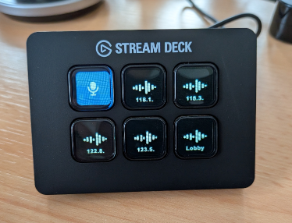

Discord using a Stream Deck Mini
Come and watch the demo…
Change channels easily
Easy Mute / PTT
Price: £60

Slide 18
BFSG Weekly
Virtual Fly-ins Update

Slide 19
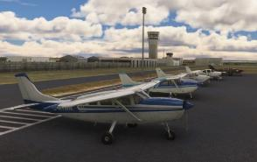
GA Virtual Flying Update
GA Virtual Flying Update
27 Jan A club flight from Clacton to Connington using an aircraft of pilot's choice. STOL type a good idea as some fields a tight fit. Compulsory landing at Marham for inclusion in Air Display. Flight plan by Mike Collins. EGSQ EG98 EGOF EGSJ EGCU EGUA EGYM EGSF (11 pilots)
03 Feb A contract in Canada transporting technicians to check condition of electrical pylons and cables between Anvil Island and Lillooet. Flight plan by Pete Norton. KFHR CYCD PZ43 CYSE CYPS CYLI CAZ5 (10 pilots)
10 Feb A GA flight up the east side of the UK, overflying the IBCC in Lincoln. All airfields enroute on the sites of WWII airfields. Flight plan by Mike Collins. EGSF EGBG EGBN EGYE EGYD IBCC EGHW EGBR (10 pilots)
17 Feb A GA flight in Thailand as part of a holiday trip. Flight plan by Pete Allnutt. VTCN VTCP VTCL VTCC. (7 pilots)
Tuesday evenings, from 19:30h
PoC: Mike C

Slide 20
Heavies Virtual Flying Update
Heavies Virtual Flying Update
Week 05 – 29 Jan – Manchester (EGCC) to Berlin Brandenburg (EDDB) – 625nm – 7 pilots
Week 06 – 05 Feb – Berlin Brandenburg (EDDB) to Bergen Flesland (ENBR) – 630nm – 8 pilots
Week 07 – 12 Feb – Bergen Flesland (ENBR) to Kemi Tornio (EFKE) – 640nm – 9 pilots
Week 08 – 19 Feb – Karachi Jinnah Intl. (OPKC) to Mumbai Chhatrapati Shivaji Maharaj Intl. (VABB) – 550nm – 11 pilots
Thursdays 18:30-21:00h
In addition, a combined BFSG and Aviators Eindhoven joint fly-in occurs once a month on Saturday mornings at 10:00hrs UK time
Aviators
07 Feb – Tripoli, Libya (HLLT) to Tozeur-Nefta, Tunisia (DTTZ) - 274nm
Tozeur-Nefta, Tunisia (DTTZ) To Houari Boumediene, Algeria (DAAG) – 346nm

Slide 21
Other News

Slide 22

BFSG Screenshot
Screenshot courtesy of Phil W

Slide 23

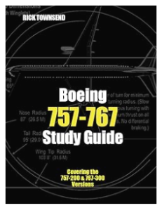
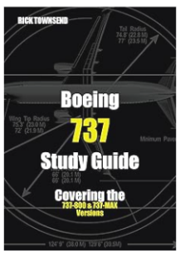
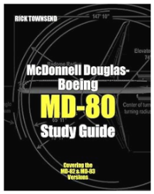
Monthly Flying Tip
Study Guides
Rick Townsend Study Guides
https://pilotstudyguide.com/books-available/

Slide 24








Monthly Flying Tip
Aircraft Guides
https://shop.keypublishing.com

Slide 25

PC Pilot magazine
PC Pilot
Released 19th Feb 26
REVIEW: INIBUILDS’ A340
Classic long-haul travel
HONEYCOMB
Bravo Lite throttles reviewed
CLASSIC ROUTES SERIES
Flight adventures from yesteryear
BLACK SQUARE BEECHCRAFT
Bonanza and Baron in depth
THE YEAR AHEAD
What to expect in 2026

Slide 26

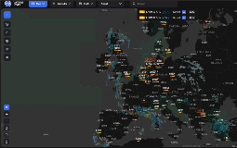


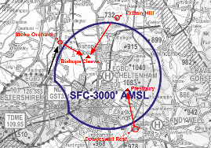
VATSIM Updates
VATSIM RADAR updates…
Cross The Pond (CTP) - This will return this Spring (date not yet announced)
CIX VFR Cheltenham Gold Cup Friday 13Mar26
  Cheltenham ATZ
  Designed for Helicopter pilots

Slide 27


MSFS2024 Sim Update 05 Beta
Sim Update 05 Beta
20 Feb 26
Career mode updates
Stability improvements
Bug fixes
EFB fixes
Aircraft fixes
Airport fixes
COST: FREE
1.7.7.0
https://forums.flightsimulator.com/t/sim-update-5-beta-1-7-7-0-release-notes-february-20-2026/758481

Slide 28

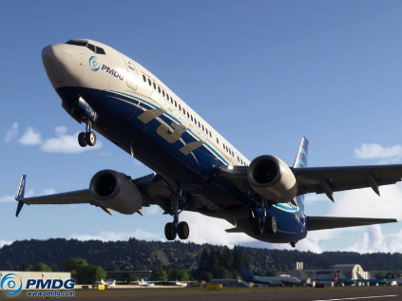
MSFS2024 PMDG 737-900
PMDG 737-900 Released
-900 and -900ER released
Longest of the 737NG series airframes
Not compatible with MSFS2020
Interchangeable equipment options for cockpit instrumentation
HUD with configurable modes
new 3D sound environment
COST:$49.99
https://pmdg.com/pmdg-737-900-for-microsoft-flight-simulator-2024/

Slide 29


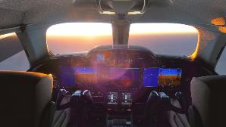
MSFS2024 FlightFX HJet 24
HJet 24 VLJ Released
Refreshed MSFS2020 version
Can be used in MSFS2024 Career Mode (Private Charter)
Rebuilt flight model, ground handling
Garmin G3000 displays
New sounds by Echo 19
EFB included w/ Navigraph
COST:$24.99 (free to MSFS2020 owners)
https://www.flightfx.io/portfolio/hjet24

Slide 30

MSFS202x City Update 13
City Update 13 - California
Sacramento
San Francisco Bay Area
Greater Los Angeles
San Diego
For MSFS 2020 and 2024
COST: FREE
https://www.flightsimulator.com/city-update-13/

Slide 31

Famous Flyer 13
Northrop T-38A Talon
Released 27th Jan 2026
Reach Mach 1.3 at 30,000ft
Northrop manufactured just under 1,200
For MSFS 2024
COST: $14.99
https://www.flightsimulator.com/famous-flyer-13/

Slide 32

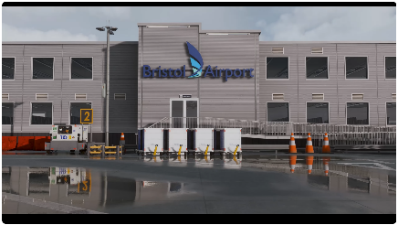
SoFly Bristol Airport
SoFly Bristol Airport (EGGD)
Released 07th Nov 2025
Built to 2025 Specs – all buildings accurate
For MSFS 2024
COST: £13.99
https://sofly.io/products/bristol-airport-eggd/

Slide 33
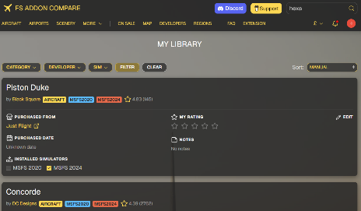
FS Addon Compare
FS Addon Compare
Login and record all your purchases:
Aircraft
Scenery
Airports
Utilities
COST: FREE
https://www.fsaddoncompare.com

Slide 34

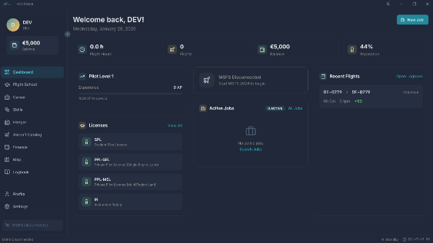
BeAPilot
Be A Pilot
For MSFS 2024
Includes:
Flight School
Career Mode
Hangar System
Skill System
Finance System
Logbook
COST: COMING SOON
https://beapilotsim.com/

Slide 35


GSX Pro Update
GSX Pro Update (3.7.6)
For MSFS 2020, 2024 (& FSX/P3D)
New Mototok (see opposite)
Seated PAX in MD-11 and A340
Pushback operator walking improved
Improved installer
“Show me this spot” for P3D & FSX
COST: FREE
https://fsdreamteam.com/products_gsxpro.html

Slide 36
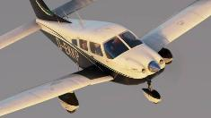
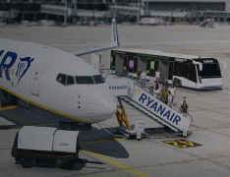
X-Plane News
12.4.0 Release (18Feb26) £ FREE
Just Flight PA-28 Archer TX/LX £30.49
Realops Ground Operations for XP12 handling plugin £21.77
https://www.x-plane.com/kb/x-plane-12-4-0-release-notes/
PA-28 Archer TX/LX
https://www.justflight.com/product/pa28-181-archer-tx-lx-xplane-12
https://realops-simulations.com/
Ground Operations

Slide 37

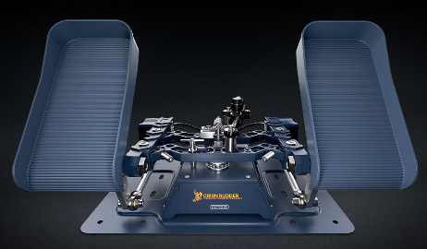
Hardware
WinCtrl opened orders for Orion32 Airbus style rudder pedals
COST: from £307.51
https://rowsfire.com/products/rowsfire-b107-b737-overhead-panel

Slide 38

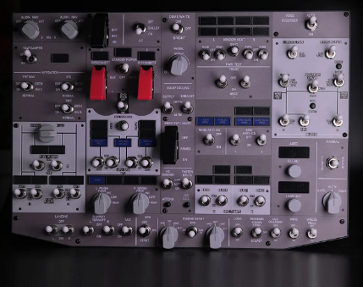
Hardware
RowsFire B107 737 Overhead
For:
MSFS 2020/2024
X-Plane 11/12
COST: $699.99
https://rowsfire.com/products/rowsfire-b107-b737-overhead-panel

Slide 39





Flight Sim PC in the Cloud
New PC Cost
Probably £2,000 over 4 years
Cloud PC Budget
£500 per year / £40 per month
Requirements
Must have enough permanent space to install the sim, scenery, aircraft etc.
Must be allowed to install any Windows addon apps
Gaming Cloud PC Providers tested

Slide 40
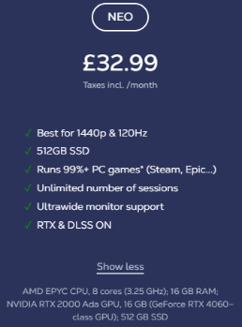
Flight Sim PC in the Cloud
Results
Airgpu, Loudplay and Vagon all fail to meet the requirements.
Shadow PC is the only system that meets the requirements and the price.
https://shadow.tech/gb/

Slide 41
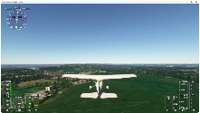
Flight Sim PC in the Cloud
Positives
Requires a good internet connection
Graphic settings can be set to max!
High frame rate, very smooth
USB controllers work seamlessly
Negatives
After 15 minutes it powers itself down
Insufficient 512 GB storage
  >> Extra storage £2.99 / 256GB / month.
No inbound network connectivity
https://www.youtube.com/watch?v=3jXyPPBC2gs
https://shadow.tech/gb/

Slide 42


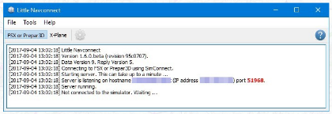
Flight Sim PC in the Cloud
Little Navmap test
created an interface app that makes Little Navmap on the laptop think it’s talking to Little Navconnect on the same network
https://shadow.tech/gb/

