Slide 1

Flight Simulation News January 2026
25 January 2026

Slide 2

BFSG News & Reviews
Presentation on news & reviews will start at:
12:00h

Slide 3
Parish Notices

Slide 4

Monthly Meeting Dates
2026 Monthly Meeting Dates
22nd February
22nd March
26th April
24th May
28th June
26th July
23rd August
27th September
25th October
22nd November
13th December

Slide 5

Inter-meeting Lunches
Meet in Chippenham
Organised by Pete A.
Next : 06th Feb 2026
Speak to Pete and be added to email list

Slide 6
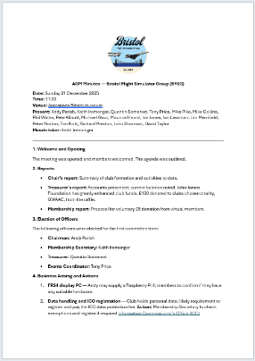
AGM 2025
Minutes will go on the website

Slide 7

Club Funds
Club Funds
2024 & 2025 we asked for £20.00
2026 we are asking for £20.00
Pay into BFSG’s NatWest account
2026 we are asking for £5.00 for Virtual Members
Members also purchase an entry ticket to Aerospace Bristol
£20.00, via the website
Aerospace Bristol Ticket valid for 12 months

Slide 8

GWAAC Donation
After the Christmas 2025 raffle, we’ve now raised £1,060 for the Great Western Air Ambulance Charity (GWAAC) over the years.

Slide 9
Project Updates

Slide 10
Projects
No. | Description | Primary PoC
1 | Aerospace Bristol FlightRadar24 feed | Tim N
2 | Formation Flying | Michael G
3 | New BFSG Club computer | Keith I

Slide 11
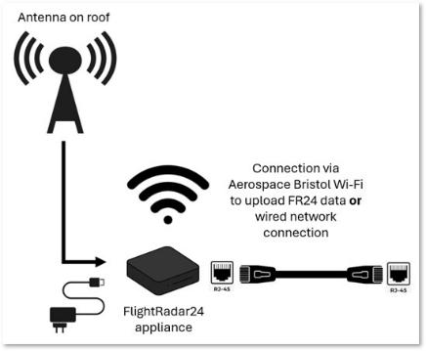
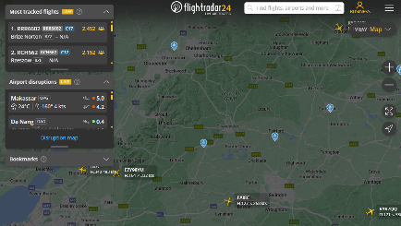
Aerospace Bristol FR24 Update
flightradar24 Install at Aerospace Bristol
BFSG is providing antenna to Aerospace Bristol (£100)

Slide 12
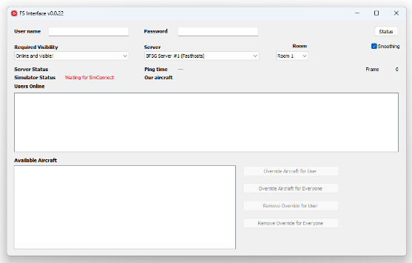
Formation Flying
New Formation Flying Client!
Developed, from scratch by one of our members, Michael
Currently working for MSFS 2020, 2024 & X-Plane 12
Currently addressing airfield elevation issue

Slide 13



Club Computer
https://www.johnjames.org.uk
Installed with:
2020
2024

Slide 14
BFSG Weekly
Virtual Fly-ins Update

Slide 15
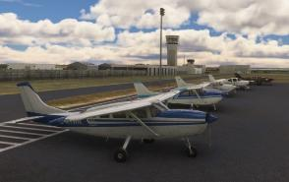
GA Virtual Flying Update
GA Virtual Flying Update
23 Dec 25 A low level sightseeing flight across Texas. Flight plan by Barry Macrae. KIAH KIWS KSGR KAXH KHOU KEFD T41 KGLS. (7 pilots)
30 Dec 25 A club flight with each pilot tasked with using three different aircraft, starting with a twin such as a Baron, then a single-engine a/c such as a Skyhawk, then a smaller light a/c such as a Cub. Flight plan by Mike Collins. EGHH EGKA EGML EGSQ. (8 pilots)
06 Jan 26 A club flight using a warbird of the pilot's choice, visiting WWII airfields. Flight plan by Mike Collins. EGXC EGYM EGTT EGIK EGUW EGMC EGSU. (10 pilots)
13 Jan 26 A club flight using light a/c in The Highlands, following the famous Jacobean Express Line running from Fort William to Mallaig, then continuing through The Highlands passing various landmarks. EGEO Fort William, Glenfinnan Viaduct, Mallaig, Skye Bridge, EG29 EGYQ, Torr Achilty Dam Power Station, EGPE Inverness. (11 pilots)
20 Jan 26 Transporting some scientists with equipment to monitor possible health hazards after a small accident at a nuclear power plant. KAVP KHZL KZER 0PS7 5PS5 PS00 KCXY Three Mile Island Power Station, KLNS. (11 pilots)
Tuesday evenings, from 19:30h
PoC: Mike C

Slide 16
Heavies Virtual Flying Update
Heavies Virtual Flying Update
01 Jan 26 – No Flight
08 Jan 26 – Hobart TAS (YMHB) to Melbourne Intl. VIC (YMML) – 387nm – 10 pilots.
15 Jan 26 – Melbourne Intl. VIC (YMML) to Sydney Kingsford Smith (YSSY) – 476nm – 10 pilots.
22 Jan 26 – Sydney Kingsford Smith (YSSY) to Brisbane Intl. (YBBN) – 428nm – 10 pilots.
Coordinated by Marcus
Thursdays 18:30-21:00h
In addition, a combined BFSG and Aviators Eindhoven joint fly-in occurs once a month on Saturday mornings at 10:00hrs UK time
10th Jan 26
New Chitose, Japan (RJCC) or Kansai Intl., Japan (RJBB) to Kadena Air Base, Japan (RODN) - 1215nm / 656nm

Slide 17
Other News

Slide 18

BFSG Screenshot
Screenshot courtesy of:
Mike C

Slide 19

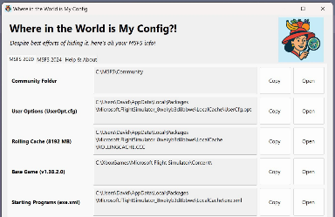
Monthly Flying Tip
Where in the World…
Simple MSFS application that:
locates paths and folders
Control bindings
Storage reports
https://flightsim.to/file/95827/where-in-the-world-is-my-config

Slide 20

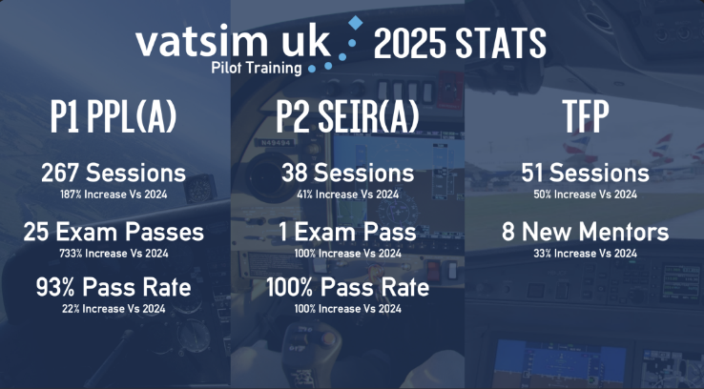
VATSIM Updates
PPL(A) = Private Pilot Licence (Aeroplane)
SEIR(A) = Single Engine Instrument Rating (Aeroplane)
TFP = The Flying Programme (https://www.vatsim.uk/pilots/the-flying-programme )

Slide 21
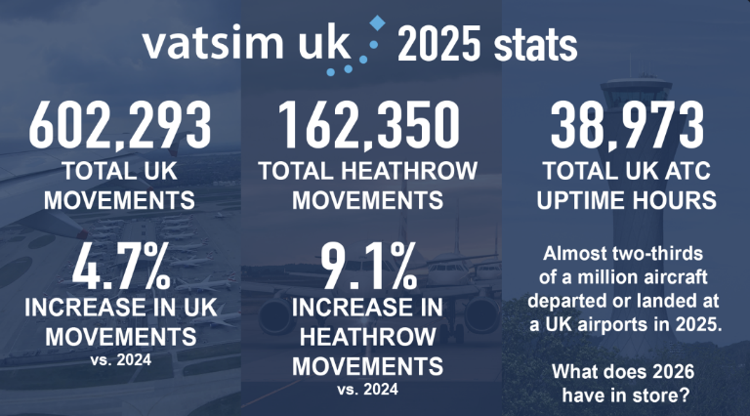
VATSIM Updates

Slide 22
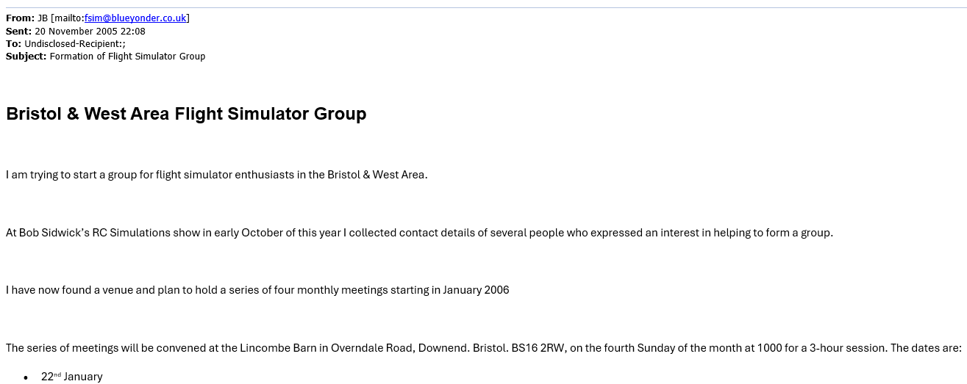
20 years of BFSG!

