Slide 1

Flight Simulation News December 2025
21 December 2025

Slide 2

BFSG News & Reviews
Presentation on news & reviews will start at:
10:00h

Slide 3
Parish Notices

Slide 4

Monthly Meeting Dates
2026 Monthly Meeting Dates
25th January
22nd February
22nd March
26th April
24th May
28th June
26th July
23rd August
27th September
25th October
22nd November
13th December

Slide 5

Inter-meeting Lunches
Meet in Chippenham
Organised by Pete A
Next : 09th Jan 2026
Speak to Pete and be added to email list

Slide 6
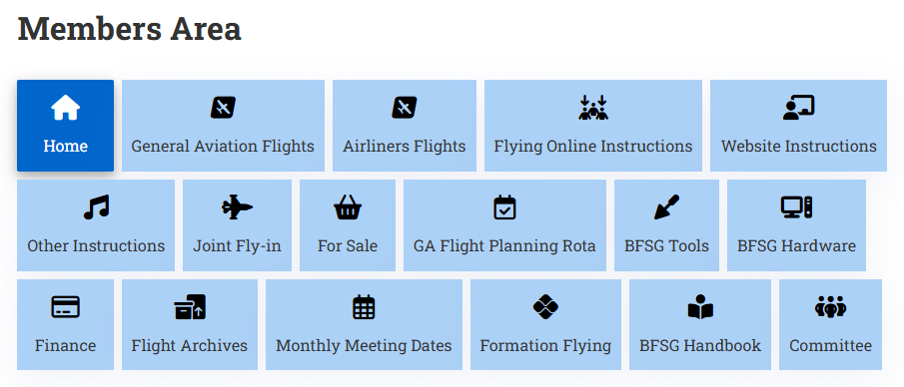
New Members Area

Slide 7
AGM 2025

Slide 8
BFSG Officer Roles

Slide 9

Club Funds
Club Funds
2023 we asked for £40.00 per member
2024 & 2025 we asked for £20.00
2026 we are asking for £20.00
Pay into BFSG’s NatWest account
Members also purchase an entry ticket to Aerospace Bristol
£20.00, valid for 12 months

Slide 10
Project Updates

Slide 11
Projects
No. | Description | Primary PoC
1 | Aerospace Bristol FlightRadar24 feed | Tim Nutt
2 | Formation Flying | Michael Gaut
3 | New computer | Keith Iremonger

Slide 12
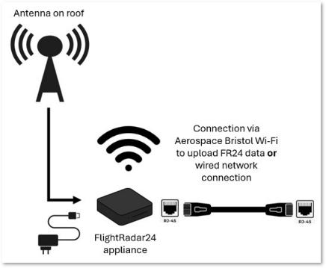
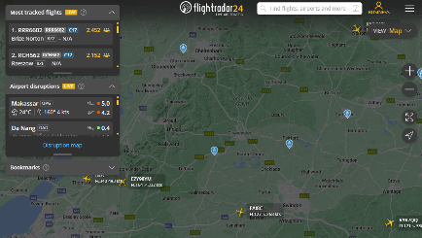
Aerospace Bristol FR24 Update
flightradar24 Install at Aerospace Bristol
BFSG is providing antenna to Aerospace Bristol (£100)

Slide 13

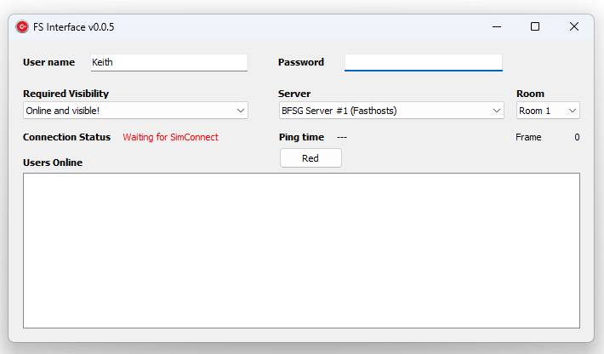
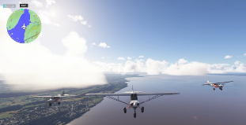
Formation Flying
New Formation Flying Client!
Developed, from scratch by one of our newest members, Michael
Currently working for MSFS 2020 and 2024

Slide 14



Club Computer
Update
43” flatscreen QLED arrived
PC arrived from Wire2Fire on Sat 20th December
https://www.johnjames.org.uk
We’ve secured £2,500 to purchase high-performance club PC & monitor/TV

Slide 15
BFSG Weekly
Virtual Fly-ins Update

Slide 16
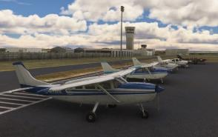
GA Virtual Flying Update
GA Virtual Flying Update
25 Nov 25 A club flight from the toe of Italy to Sicily including an orbit of Mount Etna. Flight plan by Mike Collins. LICR Etna LICC LISR LISC LICJ (10 pilots)
02 Dec 25 Smuggling flight in Israel, then into Jordan Flight plan by Ian Lassman. LLBG "collect stuff then deliver stuff" LLEY OJ39 (11 pilots)
09 Dec 25 Transporting prospective buyers of property around Corsica. Flight plan by Bob Barry. LFKB LFKG LFKF LFKO LFKJ LFKC (11 pilots)
16 Dec 25 Transporting groups of anglers in British Columbia using water aerodromes. Flight plan by Tim Nutt. W33 CAB3 CAC8 CYHC CAV7 CAE7 (9 pilots)
Tuesday evenings, from 19:30h
PoC: Mike Collins
Flights planned for 23rd & 30th Dec.

Slide 17
Heavies Virtual Flying Update
Heavies Virtual Flying Update
Week 48 – 27th Nov – Adelaide Intl SA (YPAD) to Sydney Kingsford Smith NSW (YSSY) – 650nm (10 pilots)
Week 49 – 04th Dec – London Gatwick (EGKK) to Innsbruck (LOWI) – 595nm (8 pilots)
Week 50 – 11th Dec – Cape Town Intl. (FACT) to Johannesburg O R Tambo Intl. (FAOR) – 725nm (8 pilots)
Week 51 – 18th Dec – Tallinn Lennart Meri (EETN) to Rovaniemi (EFRO) – 455nm (9 pilots)
Week 52 – 25th Dec – No Flight
Thursdays 18:30-21:00h
No Virtual Airliner flights Christmas Day & New Years Day
Next Thursday flight on 08th Jan 2026
In addition, a combined BFSG and Aviators Eindhoven joint fly-in occurs once a month on Saturday mornings at 10:00hrs UK time
06th December
Lagos Murtala Muhammed (DNMM) to Monrovia Roberts Intl. (GLRB) - 830nm

Slide 18
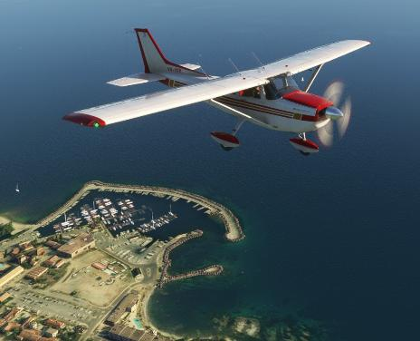
BFSG Screenshot
Screenshot courtesy of: Mike Collins

Slide 19
Monthly Flying Tips
2025 Monthly Tips
Started series in March
March – Environmental Lapse Rate - 2ºC / 1,000ft
April – Checklist Discipline – Operation → Indication
May – Height on approach – Multiply by 3 & add two zeros
July – CAA’s Skyway Code book
August – Instrument Scan
September – Use a Checklist
October – GlideX software
November – Keyboard shortcut sheets

Slide 20


VATSIM Updates
Cambridge (EGSC)
VATSIM UK celebrate the run up to Christmas by staffing Cambridge Airport on Sunday 21st December.
https://vatsim-radar.com/events/17794

Slide 21
BFSG Year in Review

Slide 22
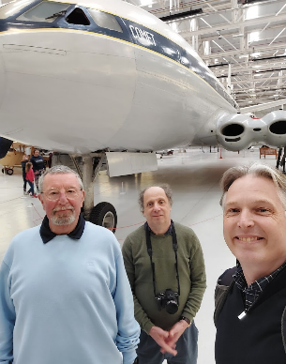
Year in Review
RAF Cosford visit
Norm’s cockpit move
BFSG Polo shirts
Facebook presence
June Open Day
New Members
Opening of NatWest account
Grant rec’d for £2,500
Appointment of Officer Roles

Slide 23
What will 2026 have in store?
Things to come in 2026
20th anniversary of BFSG!
Museum visit
Arrival of BFSG computer
UK Flight Simulator show ?
Annual Open Day

