Slide 1

Flight Simulation News October 2025
26 October 2025

Slide 2

BFSG News & Reviews
Presentation on news & reviews will start at:
12:00h

Slide 3
Parish Notices

Slide 4


Monthly Meeting Dates
2025 Monthly Meeting Dates
2026 dates for your diary:
25th January
22nd February
22nd March
26th April
24th May
28th June
26th July
23rd August
27th September
25th October
22nd November
13th December
Sun 23rd November
Normal meeting
Sun 14th December
Christmas Buffet and AGM

Slide 5
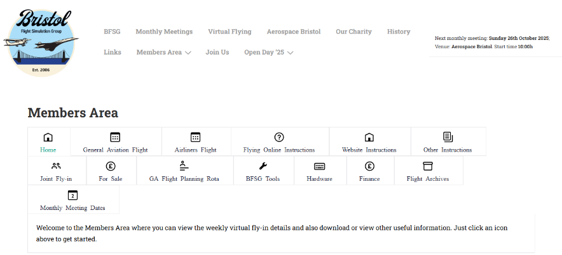
Monthly Meeting Dates

Slide 6
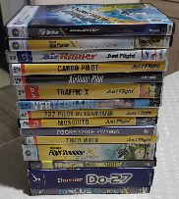

Old flight simulator software
Old flight simulator software
Many of us have old software..
So far, now raised: £464.00
Please continue to bring along, if happy for proceeds to go to club funds.
Anybody have this?

Slide 7


BFSG Merchandise
BFSG Merchandise
Mugs
5.00 each
Just 7 mugs left
Polo Shirts
More can be ordered, on request

Slide 8

Advertising
Facebook Group update

Slide 9
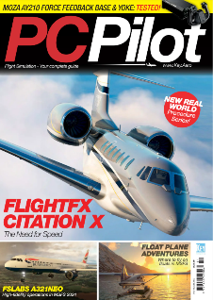
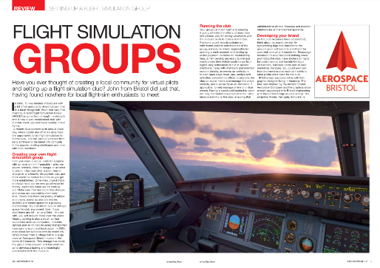
PC Pilot magazine
Nov/Dec Issue of PC Pilot now available!
https://www.key.aero/pcpilot

Slide 10
Project Updates

Slide 11
Projects
No. | Description | Primary PoC
1 | Aerospace Bristol FlightRadar24 feed | Tim N
2 | Concorde Cockpit Visuals Update | Tony P
3 | Club Terms of Reference documents & AGM | Keith I

Slide 12
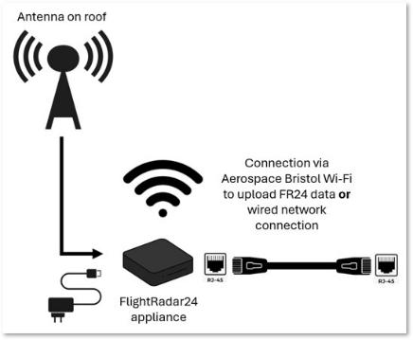
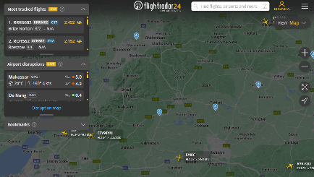
Aerospace Bristol FR24 Update
flightradar24 Install at Aerospace Bristol
BFSG is providing antenna to Aerospace Bristol (£100)

Slide 13
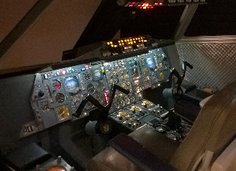
Aerospace Bristol Concorde Cockpit
Upgrading the Visuals for Concorde Cockpit
Current visuals are using the aging FSX
We’re talking John Derrick and John Britton
Latest proposal is to recreate a flight from Heathrow to Washington
Use a flight commentary from Capt John Hutchinson taken from a BBC film with Noel Edmunds
John has already edited the YouTube video to just leave the comments by Capt Hutchinson
Aerospace Bristol Concorde Cockpit

Slide 14
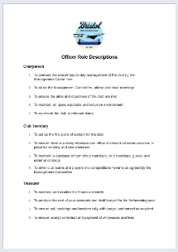

Club Terms of Reference
We now have the following for review by the group:
BFSG Officer Roles
BFSG Club Constitution
BFSG Code of Ethics and Behaviour
BFSG Privacy Policy
Looking to release as version 1.0 in November
Endorsed at inaugural BFSG AGM in December

Slide 15
BFSG Officer Roles
Closing date for nominations: 30th Nov.
Votes via survey form will quickly follow.
Electing officer roles at AGM: 14th Dec.
Nominations for:
Chair
Club Secretary
Treasurer
Optional Role:
Social Secretary

Slide 16
BFSG Weekly
Virtual Fly-ins Update

Slide 17
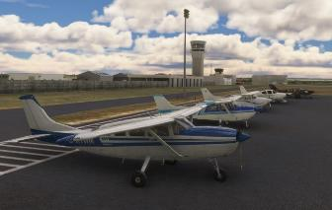
GA Virtual Flying Update
GA Virtual Flying Update
30 Sep 25 A scenic trip around the islands in the Firth of Clyde. Flight plan by Tim N. EGPF EGRT EGIS EGEY EGPI EGDA EGEC EGPK (12 pilots took part).
07 Oct 25 A flight into Lukla in Nepal. Flight plan by Dave S. VEBD VNVT VNBJ VNLD VNLK (11 pilots took part).
14 Oct 25 A trip from The Algarve to Gibraltar. Flight plan by Barry. LPFR LEMF LERT LEJR LXGB (9 pilots took part)
21 Oct 25 Gliding in The Alps. Flight plan by Pete N. LOKL LIVQ LOWZ LOWI LOIR (8 pilots took part)
Tuesday evenings, from 19:30h
PoC: Mike C

Slide 18
Heavies Virtual Flying Update
Heavies Virtual Flying Update
Week 40 – 02 Oct Belgrade Nikola Tesla (LYBE) to Innsbruck (LOWI) 470nm – 10 pilots
Week 41 – 09 Oct Reggio Calabria (LICR) to Genoa Sestri (LIMJ) 509nm – 8 pilots
Week 42 – 16 Oct Palma De Mallorca (LEPA) to Sion (LSGS) 535nm – 8 pilots
Week 43 – 23 Oct Tivat (LYTV) to Santorini (LGSR) 515nm – 9 pilots
Thursdays 18:30-21:00h
Current aim: to re-fly some of our earliest flights from Q1 2009
Flights were produced by Ollie A (RIP) and Phil D
PoC: Marcus S
In addition, a combined BFSG and Aviators Eindhoven joint fly-in occurs once a month on Saturday mornings at 10:00hrs UK time
11th Oct
Catania-Fontanarossa (LICC) to Naples-Capodichino Intl. (LIRN) - 211nm
Naples-Capodichino Intl. (LIRN) to Pisa Intl. (LIRP) – 249nm

Slide 19
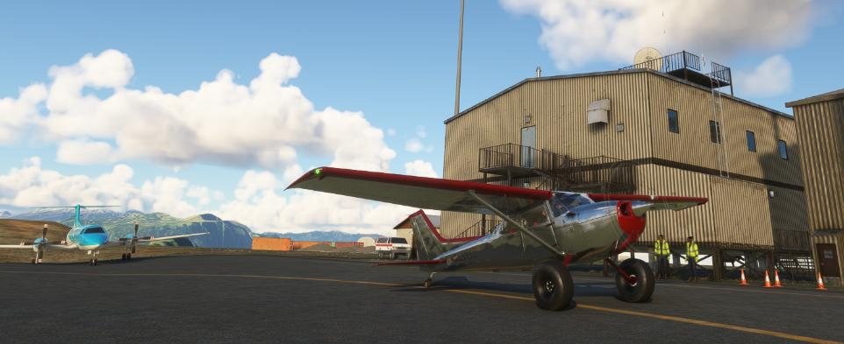
BFSG Screenshot

Slide 20






Monthly Flying Tip
Any screen, any device
https://www.asus.com/content/glidex/

Slide 21
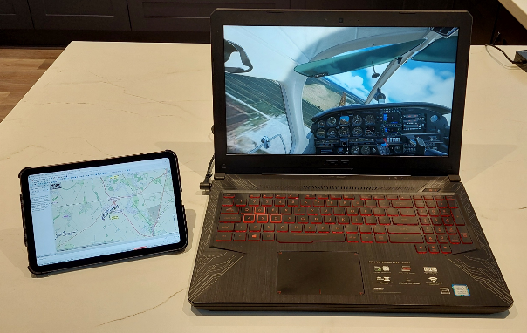

Monthly Flying Tip
Extend your Windows flight simulator computer to:
Android tablet
iPad
laptop
https://www.asus.com/content/glidex/

Slide 22


VATSIM Updates
ESPRESSO EXPRESS
VATSIM UK and VATSIM Italy invite you to take part in a fully staffed evening
London Stansted (EGSS) and East Midlands (EGNX)
to
Milan Bergamo (LIME).
https://my.vatsim.net/events/espresso-express

Slide 23

VATSIM Updates
Navigraph Partnership Announcement
Real-world navigation data powering VATSIM’s systems
Sector files and downloads prepared and delivered by AeroNav
Improved experience for virtual controllers using tools like EuroScope
https://forum.vatsim.net/t/partnership-announcement-vatsim-x-navigraph/10185

Slide 24
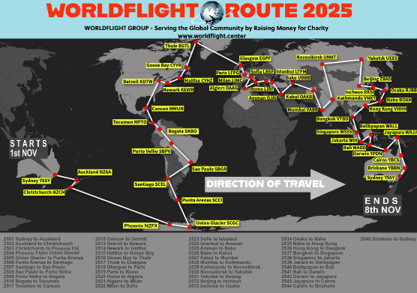
VATSIM Updates
WorldFlight 2025
Sat 01st Nov - Sat 08th Nov 25
Scenery list provided (both payware and freeware)
Started in 1999
anyone can fly along and join the event at any time of the day
https://www.worldflight.center/routemap

Slide 25

VATSIM Updates
Bonfires & Beacons
Sun 02nd Nov over Sussex airspace
19:30h to 22:00h
VATSIM UK & Orbx
Deanland (EGKL)
Shoreham (EGKA)
Lydd (EGMD)

Slide 26
BFSG Flight Simulator News & Reviews

Slide 27


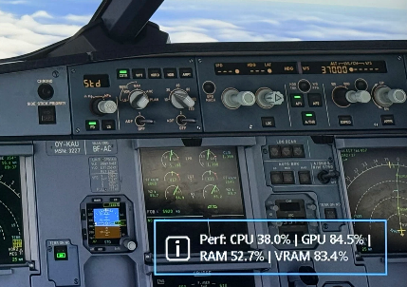
AerotuneMFS
AeroTuneMFS
AI-powered Performance Optimizer
For MSFS 2020 and 2024
Tunes parameters like TLOD*, Object LOD, cloud quality, and shadows
uses live telemetry and optional machine-learning models to make small, real-time adjustments
Connects through SimConnect
COST: FREE
https://flightsim.to/file/95050/aerotunemfs
* TLOD = terrain level of detail

Slide 28
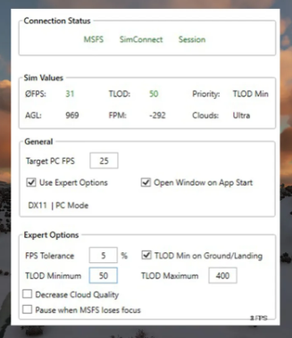
Auto FPS
Auto FPS
Been around since 2024
Available for MSFS 2020 and 2024
dynamically adjusts simulator settings to maintain a desired FPS (frames per sec)
adjusts 2 settings:
terrain level of detail (TLOD)
cloud quality
COST: FREE
https://github.com/ResetXPDR/MSFS_AutoFPS

Slide 29

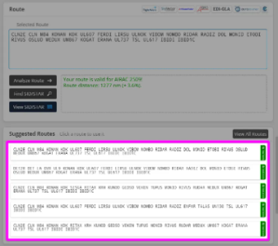
Navigraph European Real World Routes
European Routes
16 Oct 25
SimBrief has integrated real-world routes data for most flights within Europe
A new green label marked Real World next to the route string
COST: FREE for Navigraph users
https://navigraph.com/blog/simbrief-routes-europe

Slide 30



Just Flight PA-28
PA-28
Archer III from Just Flight and Thranda Design
six paint schemes
XP12 visual upgrades
fully reworked flight dynamics
new multi-function EFB tablet
COST: £30.49
20% discount for owners of the XP-11 Archer III
https://www.justflight.com/product/pa28-181-archer-iii-xplane-12

Slide 31

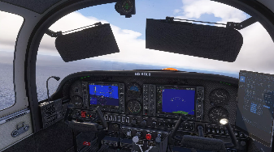

BRSIM DESIGNS AA-5B Tiger Update
AA-5B Tiger G1000
four-seat, light aircraft
8 liveries
used for touring and training
Custom Flight Dynamics
G1000 Dual Screen With Autopilot
COST: ~ £20.82
Special upgrade price available
https://secure.simmarket.com/brsimdesigns-brsimdesigns-aa-5b-tiger-g1000-msfs2420.phtml

Slide 32

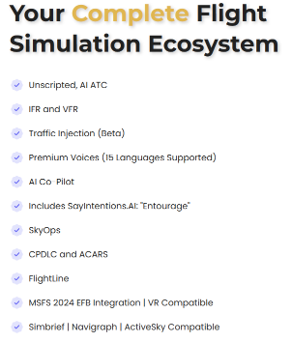
SayIntentions.AI
Price increases from 01 Nov
Was $19.95 per month
Will be $23.95 per month
Existing subscribers will continue paying their current rate indefinitely, provided their plan remains active
https://www.sayintentions.ai/price-change

Slide 33

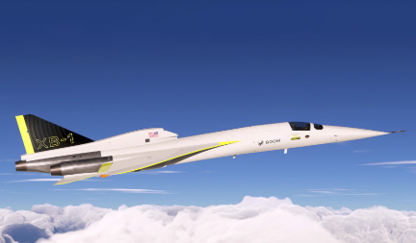

Microsoft Flight Simulator for Sony PS5
MSFS2024 on PS5
The PS5 trailer showed the Boom XB-1 !
Coming 08 Dec 25, with SU4 integrated
Cross-play not supported
Marketplace purchases on PC and Xbox will not transfer to PlayStation
Update in 2026 will support PS VR2
“The Sony PlayStation 5 (PS5) is a cutting-edge gaming console that delivers ultra-fast load times, stunning 4K graphics, and immersive gameplay powered by its custom SSD and powerful GPU.”

Slide 34
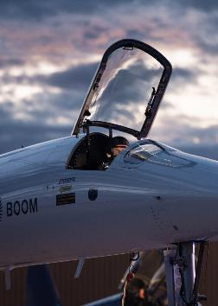

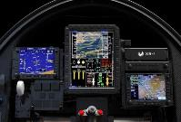
Boom XB-1
Boom XB-1 on MSFS 2024
The Boom XB-1 (Baby Boom)
Developed by Boom Supersonic as a scaled-down demonstrator for Overture supersonic airliner (below)
Cost: FREE
Enables Supersonic flight!
Playable on PC, Xbox and PS5
Maiden flight: 22 Mar 24
First Supersonic Flight: 28 Jan 25
Speed Achieved: Mach 1.1+
Noise: No sonic boom
Altitude reached: 35,000ft
Retired: 15 Feb 25
https://boomsupersonic.com

Slide 35
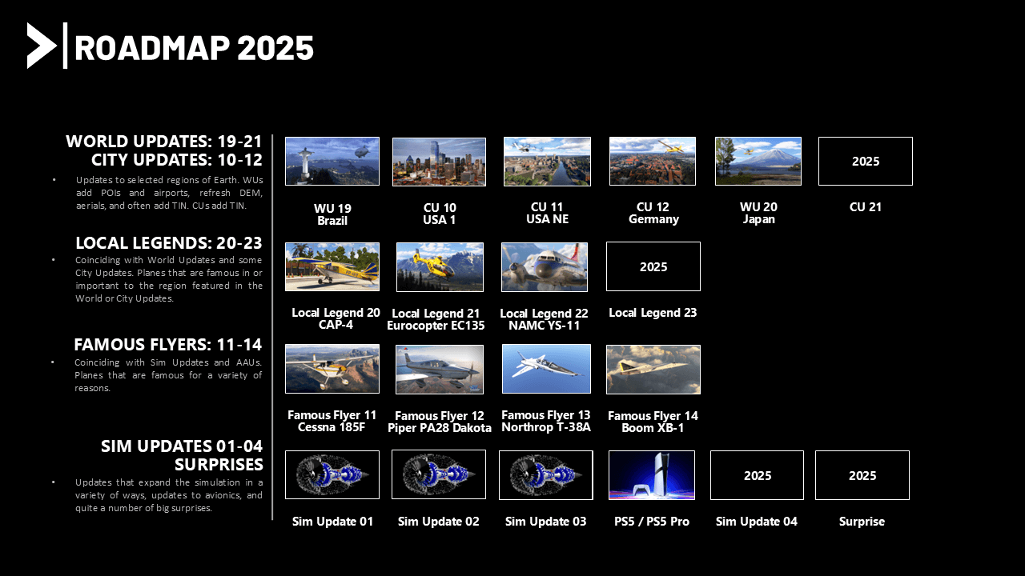
Microsoft Flight Simulator Roadmap
Notes:
27 Jun 25 – Piper PA-28 Dakota released.

Slide 36

MSFS 2020 Roadmap
MSFS 2020 Roadmap
Sim Update 16.1: A future patch specifically aimed at fixing critical crash issues linked to Nvidia Streamline DLLs (used for AI powered graphics)
Sim Update 17: Scheduled for summer 2026, following a yearly Sim Update pattern
City and World Updates: These will continue and be released simultaneously for both MSFS 2020 and MSFS 2024
Content Porting: Microsoft might port some aircraft and missions from MSFS 2024 to MSFS 2020 where technically feasible
Notes:
Sim Update 16 came out on 05 Aug 25

Slide 37

MSFS 2024 Roadmap
MSFS 2024 Roadmap
Career Mode: continues to evolve, with heavy and super-heavy cargo missions being introduced soon
Air Racing: Red Bull Air Race mode is planned for release in Dec 25
SU4: Sim Update 4 released this year – night lighting, performance, multi-core, atmospherics & cloud

Slide 38
Other News

Slide 39

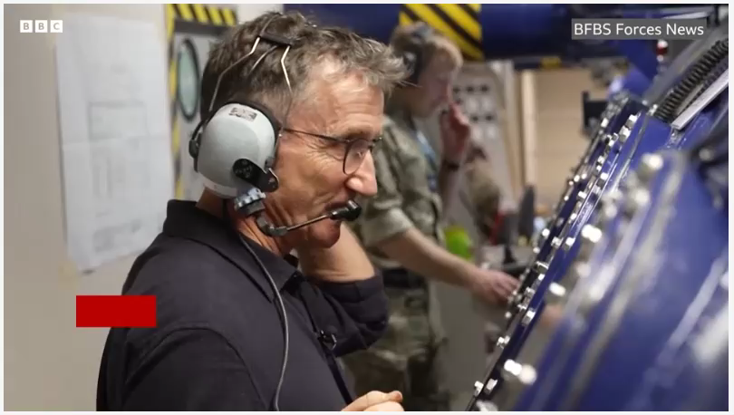
Tunnock’s teacakes
60 years ago, Tunnock's teacakes were banned from RAF flights!
in the summer of 1965, a captain and student pilot forgot they had placed unwrapped teacakes above their instrument panels
https://www.bbc.co.uk/news/articles/c20x5x0g3kqo

