Slide 1

Flight Simulation News September 2025
28 September 2025

Slide 2

BFSG News & Reviews
Presentation on news & reviews will start at:
12:00h

Slide 3
Parish Notices

Slide 4

Dates
2025 Monthly Meeting Dates
Sun 26th October
Sun 23rd November
Sun 14th December
Christmas Do and AGM

Slide 5


BFSG Merchandise
BFSG Merchandise
Mugs
5.00 each
Just 7 mugs left
Polo Shirts
More can be ordered, on request

Slide 6

Advertising
Facebook Group update

Slide 7
Project Updates

Slide 8
Projects
No. | Description | Primary PoC
1 | Aerospace Bristol FlightRadar24 feed | Tim N
2 | Concorde Cockpit Visuals Update | Tony P
3 | Club Terms of Reference documents | Andy P

Slide 9

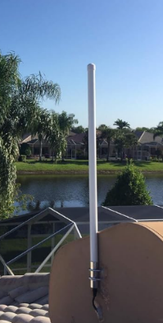
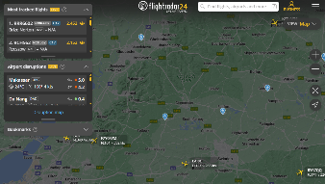
Aerospace Bristol FR24 Update
flightradar24 Install at Aerospace Bristol
Update from Tim & Pete
Demo kit

Slide 10
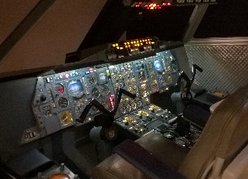
Aerospace Bristol Concorde Cockpit
Upgrading the Visuals for Concorde Cockpit
Current visuals are using the aging FSX
We’re talking John Derrick and John Britton
Latest proposal is to recreate a flight from Heathrow to Washington
Use a flight commentary from Capt John Hutchinson taken from a BBC film with Noel Edmunds
John has already edited the YouTube video to just leave the comments by Capt Hutchinson
Aerospace Bristol Concorde Cockpit

Slide 11
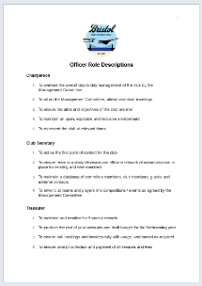

Club Terms of Reference
We now have the following for review by the group:
BFSG Officer Roles
BFSG Club Constitution
BFSG Code of Ethics and Behaviour
BFSG Privacy Policy
All comments received by Sun 28th Sep 2025
Final edits made in October
Released a version 1.0 in November
Endorsed at inaugural BFSG AGM in December

Slide 12


Museum Visit?
South West Aviation Museum
Open Sat & Sun 10am to 4pm
By car: 1:40hr from Aerospace Bristol
By public transport: train, then change at Cardiff for 304 bus
Adults £10
https://www.southwalesaviationmuseum.com

Slide 13
BFSG Weekly
Virtual Fly-ins Update

Slide 14

GA Virtual Flying Update
GA Virtual Flying Update
02.09.2025 A scenic flight in North Island NZ. Flight plan by Mike Collins.
NZKD NZGB NZUN NZWV NZMA NZTG NZRO NZWK. (7 pilots took part).
09.09.2025 Cessna 152 Owners Club Challenge Flight. Southern UK. Last leg flying with no power. Flight plan by Richard Preston.
EGHA EGHO EGHP EGHL EGTD EGVS EGHR EGIF. (10 pilots took part)
16.09.2025 A flight around the Bristol area collecting milk samples for Bristol University. Flight plan by Ian Lassman.
EGUS EGRR EGZC EG17 EGYF EGVD EGNN EG43 EGQX EG03 EGXG. (7 pilots took part)
23.09.2025 A commercial flight in France and Switzerland. Flight plan by Bob Barry. LFSB LSZG LSGN LSGL LSGG LFHZ. (9 pilots took part)
Tuesday evenings, from 19:30h
PoC: Mike C

Slide 15
Heavies Virtual Flying Update
Heavies Virtual Flying Update
Week 31 – 31 Jul Nuremburg (EDDN) to Mostar (LPPT) – 535nm – 8 pilots.
Week 32 – 07 Aug Nashville Intl. (KBNA) to Wichita Eisenhower Natl. (KICT) – 555nm – 8 pilots.
Week 33 – 14 Aug Wichita Eisenhower Natl. (KICT) to Minneapolis-St Paul Intl. (KMSP) – 550nm – 8 pilots.
Week 34 – 21 Aug Naha Intl. (ROAH) to Tainan - Taiwan (RCNN) – 515nm – 7 pilots.
Week 35 – 28 Aug Hilo Intl. (PHTO) to Lihue - Hawaii (PHLI) ; Divert to Honolulu (PHNL) – 290nm - 9 pilots.
Thursdays 18:30-21:00h
Current aim: to re-fly some of our earliest flights from Q1 2009
Flights were produced by Ollie A (RIP) and Phil D
PoC: Marcus S

Slide 16
Heavies Virtual Flying Update
Heavies Virtual Flying Update
Week 36 – 04 Sep Tainan - Taiwan (RCNN) to Manila (RPLL) – 519nm – 9 pilots
Week 37 – 11 Sep Manila (RPLL) to Kota Kinabalu - Malaysia (WBKK) – 604nm – 9 pilots
Week 38 – 18 Sep Amman Queen Alia Intl. (OJAI) to Rodos Diagoras (LGRP) – 511nm – 8 pilots
Week 39 – 25 Sep Rodos Diagoras (LGRP) to Belgrade Nikola Tesla (LYBE) – 700nm – 8 pilots
Thursdays 18:30-21:00h
Current aim: to re-fly some of our earliest flights from Q1 2009
Flights were produced by Ollie A (RIP) and Phil D
PoC: Marcus S
In addition, a combined BFSG and Aviators Eindhoven joint fly-in occurs once a month on Saturday mornings at 10:00hrs UK time
13 Sep
Bilbao (LEBB) to Madeira (LPMA) - 919nm

Slide 17


BFSG Screenshot
Pilatus PC-12 from MSFS2024

Slide 18

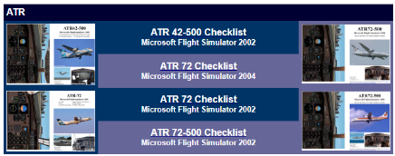
Monthly Flying Tip
Use a Checklist
Why use a checklist?
Enhances immersion
Stops mistakes!
Deepens system knowledge
Develops good muscle memory
Helps you solve problems
http://freechecklists.net/simchecklists.asp

Slide 19


VATSIM Updates
24H of VATSIM
6th edition of the event
24hrs of VATSIM
04th October 2025
Over 20 airports featured, including:
Palma De Mallorca (LEPA)
Belfast Int’l (EGAA)
Ottawa (CYOW)
Keflavik (BIKF)
Singapore (WSSS)
Auckland (NZAA)
https://my.vatsim.net/events/24-hours-of-vatsim-october-2025
https://my.vatsim.net/events/

Slide 20
BFSG Flight Simulator News & Reviews

Slide 21



WingFlex A320 Overhead CUBE
Overhead Panel
Launching A320 Overhead in September
Accompanies their RMP Combo
80% size
feature 64 buttons and knobs
Available to pre-order
COST: No price yet
https://www.wingflexsim.com

Slide 22

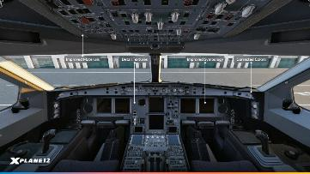


X-Plane 12.3.0 Beta
Beta Release
A330-300 overhaul – better visuals, VNAV, FBW, better lighting
Weather Radar, with real-time 3D cloud precipitation scanning
Developers get new APIs
hand-crafted Dubai Airport (OMDB)
Synthetic Vision on the G1000/X1000, rendering terrain, runways, obstacles, and airport signage in 3D on the PFD
Better multi-player through ExVis
https://www.youtube.com/watch?v=ZHdL1SdH2mE

Slide 23
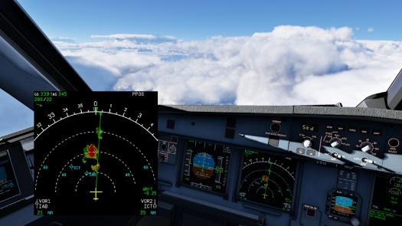
ToLiss Weather Radar (X-Plane)
ToLiss A319 v1.11 & A321 v1.8 Betas
Weather scanning on ND
Dedicated WX Radar page on the ND, complete with tilt and gain
FREE
https://toliss.com

Slide 24
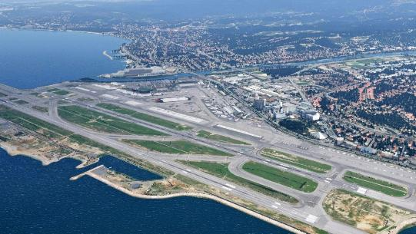
JustSim Nice for X-Plane 12
Nice Côte d’Azur (LFMN)
France’s 3rd busiest airport
2 runways, 3 terminals
Launched on 15Aug25
Designed specifically for XP12
Previous owners of XP11 get 20% off
Optimised performance with X-Life and World Traffic 2
COST: Approx. £13.75
https://store.x-plane.org/LFMN--Nice-Cote-dAzur-NG-XP12_p_2077.html

Slide 25
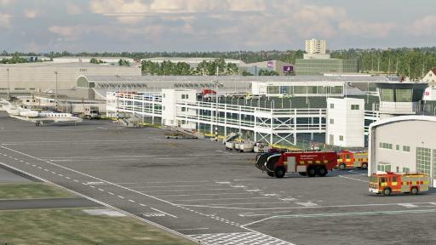
Aeroscape Southampton for X-Plane 12
Southampton (EGHI)
Aeroscape’s first XP12 product
Launched via iniBuilds Store on 28Aug25
custom ground textures
realistic clutter
Animated jetways
authentic night lighting
COST: £7.99
https://inibuilds.com/products/aeroscape-southampton-eghi-xp

Slide 26
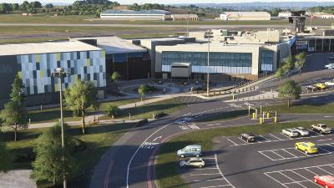
iniBuilds Leeds Bradford V2 Enhanced
Leeds Bradford (EGNM) for MSFS2024
Updated to the latest real-world layout, including the new terminal extension
Fully reworked ground textures and markings to MSFS24 standards
Existing owners can upgrade for £3.99 using code EGNM-UG at checkout.
COST: £9.99
https://inibuilds.com/products/inibuilds-leeds-bradford-egnm-msfs

Slide 27
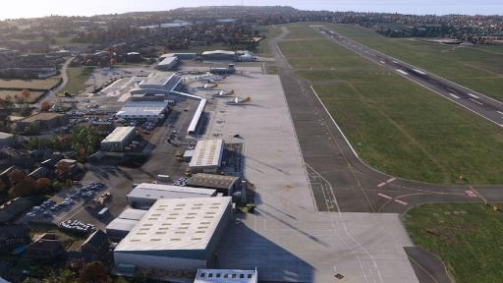
RealVFR Guernsey Airport
Guernsey (EGJB) for MSFS2024
Accurate Terrain Elevation
Custom Night Lighting
Two detailed hangars available
Fully Modelled Control Tower Interior
Iconic Guernsey hedgerows recreated in 3D
COST: £15.00
https://realvfr.com/psac.html

Slide 28
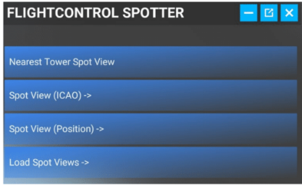
Fabio Merlo FlightControlSpotter
FlightControlSpotter
Enjoy the sim from a plane spotter’s perspective
Nearest Tower View
Spot View by ICAO
Custom Spot Views
Manage Your Views
Drone Camera Integration
Quick Return to Cockpit
Launch discount available until 28Sep25
COST: 12.50EURO
https://flightcontroltools.com/flightcontrolspotter-features/

Slide 29

Fenix Simulations A320 BFU Patch 2
BFU Patch 2
new update for its Airbus A320/A319/A321 series
second update since the ‘BFU’ update
rebuild of the auto-thrust system
new audio system and sounds
get the update via the Fenix Installer
FREE
https://fenixsim.com/blog/entries/2025-09-02_bfu_patch2/

Slide 30

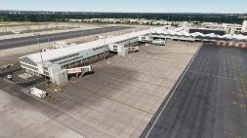
UK2000 Scenery Birmingham Airport
Birmingham (EGBB) for MSFS2024
Released 22Aug25
Full detail Buildings
Realistic Ground Markings
Stunning Night Effects
Static GA aircraft
Animated Jetways
COST: £10.99
https://www.uk2000scenery.com/products.htm

Slide 31
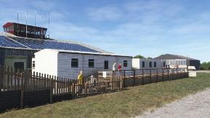
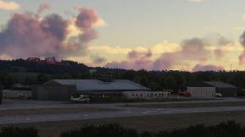
Burning Blue Design Welshpool Airport
Welshpool (EGCW) for MSFS2024
over 100 custom 3D objects
custom night lighting
accurate runways, taxiways and custom taxi signs
COST: £8.95
https://burningbluedesign.com/product/welshpool/

Slide 32

World Update 20: Japan
World Update 20: Japan
Hokkaido Spaceport (JP-0052) – also known as Taiki Multi-Purpose Aerospace Park
Kitakyushu Airport (RJFR) – located on an artificial island
Rishiri Airport (RJER) – on the volcanic island of Rishiri
Sado Airport (RJSD) – on the island of Sado
Satsuma Iōjima Airport (RJX7) – a private airfield on Iōjima
COST: FREE
https://www.flightsimulator.com/world-update-20/

Slide 33

Local Legend 21 for MSFS2024
Eurocopter EC135 T1
Nemeth Designs
Twin engine, light utility
A pilot favourite
The last of 4 aircraft promised free by Microsoft
COST: FREE for MSFS2024 users
https://www.flightsimulator.com/local-legend-21/

Slide 34

Local Legend 22
NAMC YS-11
Twin turbo-prop
Maiden flight 30Aug62
182 manufactured in total
2 pilots, 64 PAX
2 variants: VIP and Passenger
COST: $19.99 or available for 7-day rental $9.99
| 3-day rental $6.99 | 1-day free
https://www.flightsimulator.com/local-legend-22/

