Slide 1

Flight Simulation News August 2025
31 August 2025

Slide 2

BFSG News & Reviews
Presentation on news & reviews will start at:
12:00h

Slide 3
Parish Notices

Slide 4

Dates
2025 Monthly Meeting Dates
Sun 28th September
Sun 26th October
Sun 23rd November
Sun 14th December
  Christmas Do and AGM

Slide 5
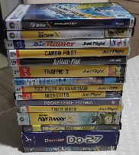

Old flight simulator software
Old flight simulator software
Many of us have old software..
So far, now raised: £440.00
Please continue to bring along, if happy for proceeds to go to club funds.
Anybody have this?

Slide 6


BFSG Merchandise
BFSG Merchandise
Mugs
5.00 each
Just 7 mugs left
Polo Shirts
More can be ordered, on request

Slide 7
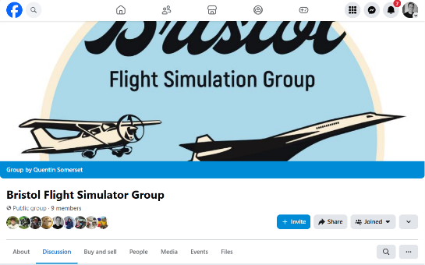
Advertising
Facebook Group update

Slide 8

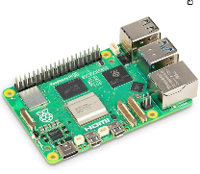
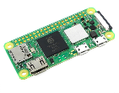
Raspberry Pi Pop Up Store!
The Raspberry Pi store was in Bristol for 2 days!
Fri 29th Aug & Sat 30th Aug
09:30 to 20:00
The Mall, Cribbs Causeway (nr M&S)
RPi Zero 2 W From £14.40
RPi v5 From £48 for 2Gb RAM model
Both run Raspberry Pi Operating System
https://www.raspberrypi.com/software/operating-systems/

Slide 9
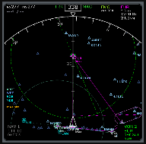
What can you do on a Raspberry Pi?
All sims
Browse to LittleNavMap using LNM’s built-in Web Server
For X-Plane
Run XHSI for Raspberry Pi for X-Plane showing 737 type
Navigation Display – xhsi.sourceforge.net
Run SimVim Panel for X-Plane - www.simvim.com
For MSFS 2020 / 2024
Run Instrument Panel - github.com/scott-vincent/instrument-panel

Slide 10
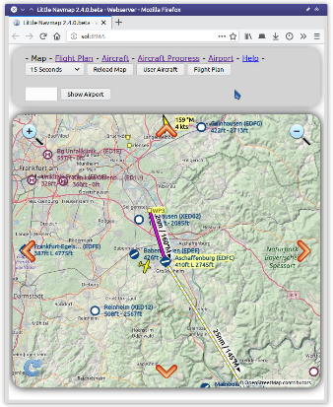
LittleNavMap Internal Web Server
LNM Internal Web Server
Little Navmap includes an internal web server showing the map, aircraft progress and airport information with an optional automatic refresh in a web browser.
The page can be accessed from any computer, tablet, smartphone or RASPBERRY PI in your local network.
Setup Guide
https://www.littlenavmap.org/manuals/littlenavmap/release/2.4/en/WEBSERVER.html

Slide 11
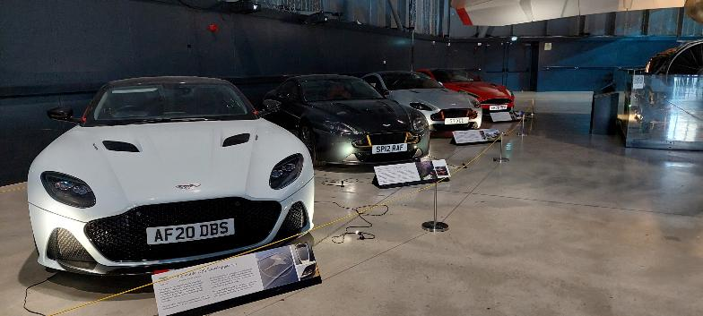
Aston Martin cars
In the Concorde hangar… until Mon 01st Sep only

Slide 12

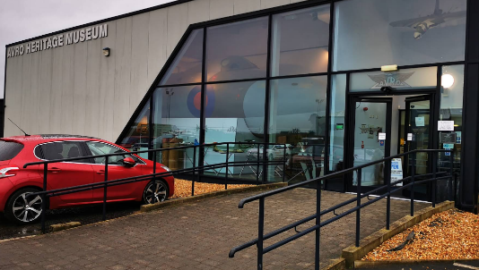
Museum Visit?
On the back of last year’s RAF Cosford trip…
South of Manchester
£9 admission
3hrs by car from Bristol
4hrs by train from Bristol Temple Meads
www.avroheritagemuseum.co.uk

Slide 13
Project Updates

Slide 14
Projects
No. | Description | Primary PoC
1 | Aerospace Bristol FlightRadar24 feed | Tim N
2 | Concorde Cockpit Visuals Update | Tony P
3 | Club Terms of Reference documents | Andy P

Slide 15

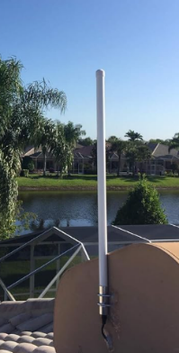
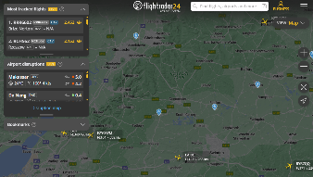
Aerospace Bristol FR24 Update
flightradar24 Install at Aerospace Bristol
Update from Tim & Pete
Demo kit

Slide 16
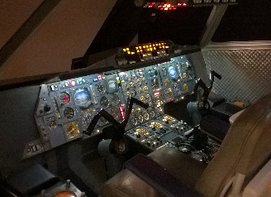
Aerospace Bristol Concorde Cockpit
Upgrading the Visuals for Concorde Cockpit
Current visuals are using the aging FSX
We’re talking John D and John B
Latest proposal is to recreate a flight from Heathrow to Washington
Use a flight commentary from Capt John Hutchinson taken from a BBC film with Noel Edmunds
John has already edited the YouTube video to just leave the comments by Capt Hutchinson
Aerospace Bristol Concorde Cockpit

Slide 17
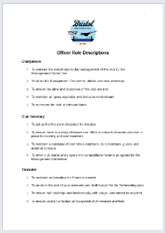
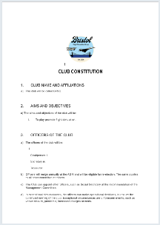
Club Terms of Reference
We now have the following for review by the group:
BFSG Officer Roles
BFSG Club Constitution
BFSG Code of Ethics and Behaviour
BFSG Privacy Policy
All comments received by Sun 28th Sep 2025
Final edits made in October
Released a version 1.0 in November
Endorsed at inaugural BFSG AGM in December

Slide 18

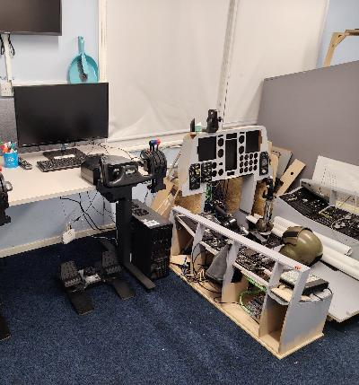

Norm PC Update
Norm’s flight sim setup now installed at 2385 Melksham Sqn.

Slide 19
BFSG Weekly
Virtual Fly-ins Update

Slide 20
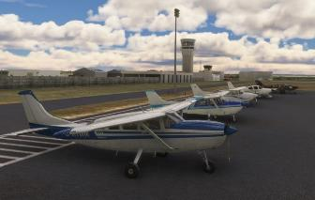
GA Virtual Flying Update
GA Virtual Flying Update
29Jul25 A secretive flight around Moscow, checking out the airbase at Stupino. Flight plan by Bob B. UUBC UUFL UBOL UUMI UBIO UUDD UUWW (9 virtual pilots)
05Aug25 A follow up of a previous flight, photographing castles in Slovakia and Czech Republic. Flight plan by Pete A. LZZI LKPT LKPO Five castles enroute. (10 virtual pilots)
12Aug25 A scenic flight in North Carolina. Flight plan by Mike C. 14A 8A7 KUKF KGEV NC14 NC06 2NCO (10 virtual pilots)
19Aug25 A scenic flight in Austria and Germany with passengers. Flight plan by John S. GTFD LOWZ LOIJ EDWW EDPN LOIR LOWI. (10 virtual pilots)
26Aug25 A passenger carrying flight in Yosemite National Park - California. Flight plan by Tony P KFAT KLSN KMOD 024 KMMH ( 12 pilots)
Tuesday evenings, from 19:30h
PoC: Mike C

Slide 21
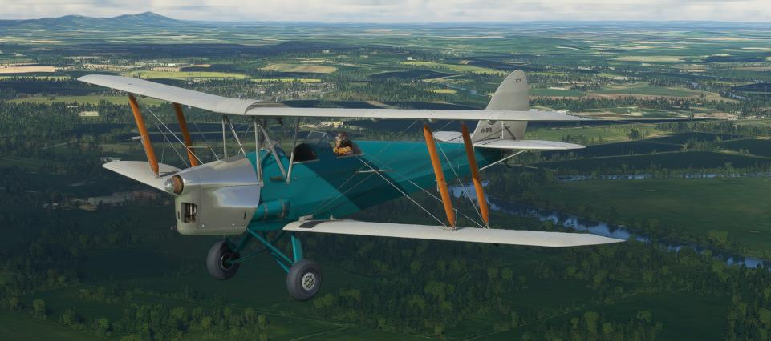
BFSG Screenshot
Best Screenshot

Slide 22

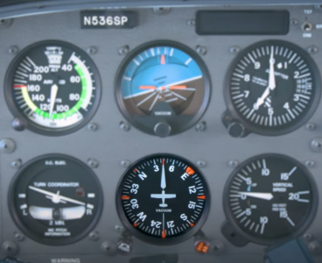
Monthly Flying Tip
Instrument Scan
Begin each scan cycle on the attitude indicator to establish aircraft pitch and bank.
Radiate outward from the attitude indicator to airspeed, altimeter, heading, and VSI—then back to the attitude indicator.
Interpret each instrument’s “full story” rather than grabbing brief glances.
Adjust your scan rhythm based on cockpit layout and flight phase (e.g., cruise vs. approach).
https://www.youtube.com/watch?v=zGhEhdJ-j1g

