Slide 1

Flying an Overhead Join
24 March 2024

Slide 2
The Overhead Join
A method for an aircraft flying VFR, to approach and safely land at an airfield.
Used a lot in the UK
especially useful at smaller airfields with no regular radio service
The default join for fixed-wing aircraft is 2000 ft QFE
to then join the circuit at 1000ft QFE
STEP 1
Establish landing runway
Ascertain circuit direction & height

Slide 3
The Overhead Join
STEP 2
If left-hand circuit, keep the airfield on your LEFT. All turns to the LEFT.
If right-hand circuit, keep the airfield on your RIGHT. All turns to the RIGHT.
STEP 3
Descend on the DEAD SIDE to circuit height. Cross up-wind end of runway at circuit height.
STEP 4
Join downwind; keep a good look-out for other aircraft in the circuit.

Slide 4
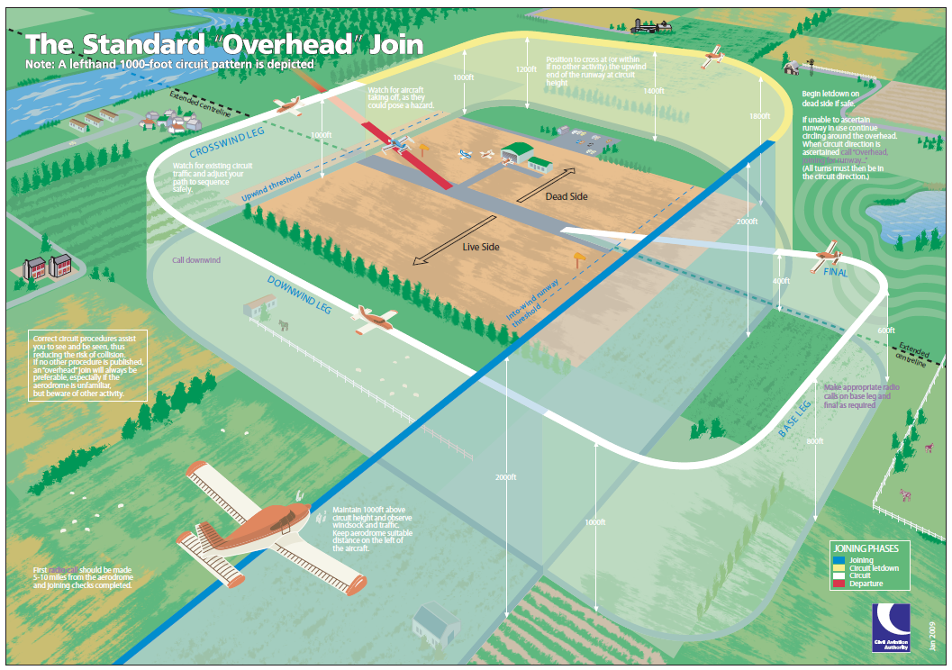
The Overhead Join

Slide 5
The Overhead Join
Simple Example – Bristol Airport
27
09

Slide 6
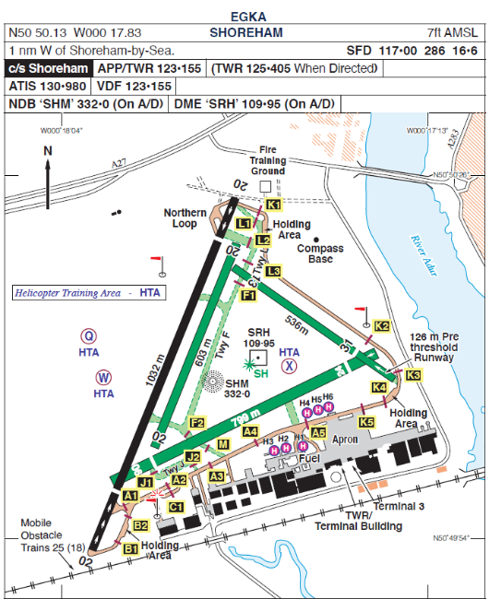
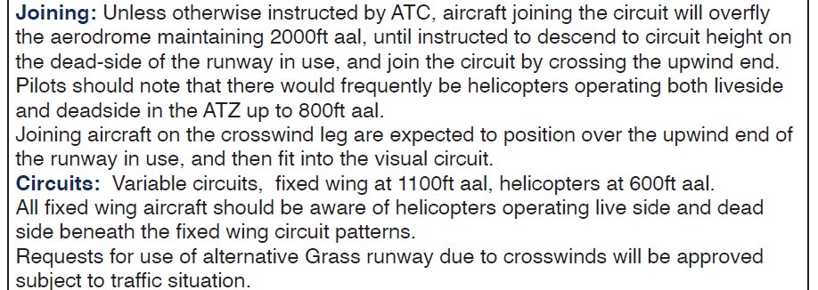
The Overhead Join
Flown Example – Shoreham Airport

